Slide 1



Since Nov. 18, 1982
Cocaine Anonymous
Carrying Its Message to the
Addict Who Stills Suffers!
Protecting C.A.’s Future by Preserving C.A.’s Legacy
“Those who cannot remember the past are condemned to repeat it.”
Santayana (in The Life of Reason, 1905)
Notes:
Good morning, good afternoon and good evening, depending on what part of the world you’re tuning in from. My name is Cameron F. and I am your C.A. World Services Archive Chair. and the Southern Ontario Cocaine Anonymous Area Archivist since 2009. Welcome everyone.

Slide 2

Ren & Stimpy explain the role of an archivist.
Notes:
Good morning, good afternoon and good evening, depending on what part of the world you’re tuning in from. My name is Cameron F. and I am your C.A. World Services Archive Chair. and the Southern Ontario Cocaine Anonymous Area Archivist since 2009. Welcome everyone.

Slide 3
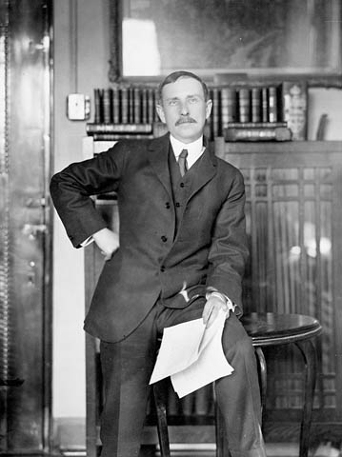
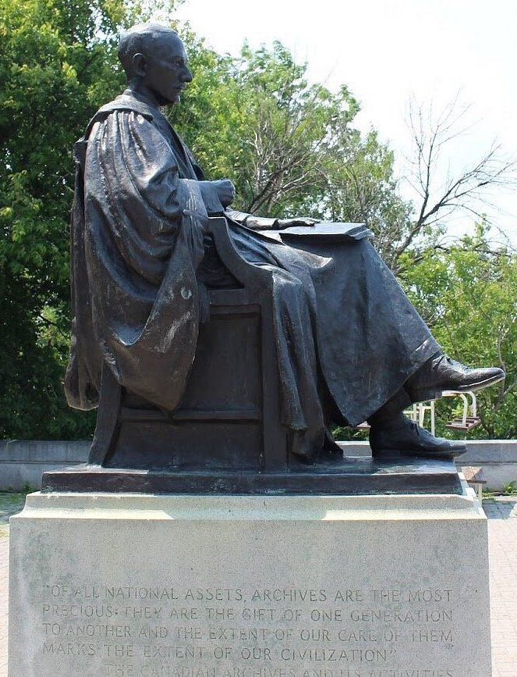
The Purpose of an Archive
Ottawa, Canada, monument of Sir Arthur George Doughty (1860-1936) A Canadian civil servant and Dominion Archivist and Keeper of the Public Records.
"Of all national assets, archives are the most precious, they are the gifts of one generation to another, and the extent of our care of them marks the extent of our civilization.”
Notes:
Good morning, good afternoon and good evening, depending on what part of the world you’re tuning in from. My name is Cameron F. and I am your C.A. World Services Archive Chair. and the Southern Ontario Cocaine Anonymous Area Archivist since 2009. Welcome everyone.

Slide 4
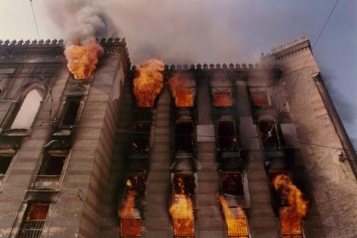
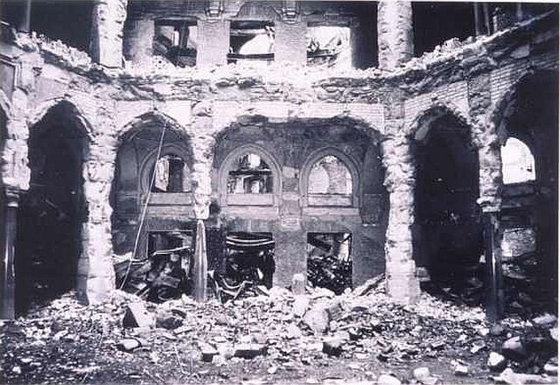
The Importance of Archives
On August 25, 1992, in the Bosnian city of Sarajevo, nearly two million books went up in flames. Fragile, 500-hundred-year-old pamphlets and vibrant Ottoman-era manuscripts disintegrated into ash as the building holding them, the National Library of Bosnia-Herzegovina, was shelled and burned. The burning of the National Library was an attack on more than physical objects, it was “cultural heritage destruction”: intentional and unnecessary destruction of sites and records that act as a community’s collective memory.
Notes:
The statues were blown up and destroyed in March 2001 by the Taliban, on orders from leader Mullah Mohammed Omar

Slide 5
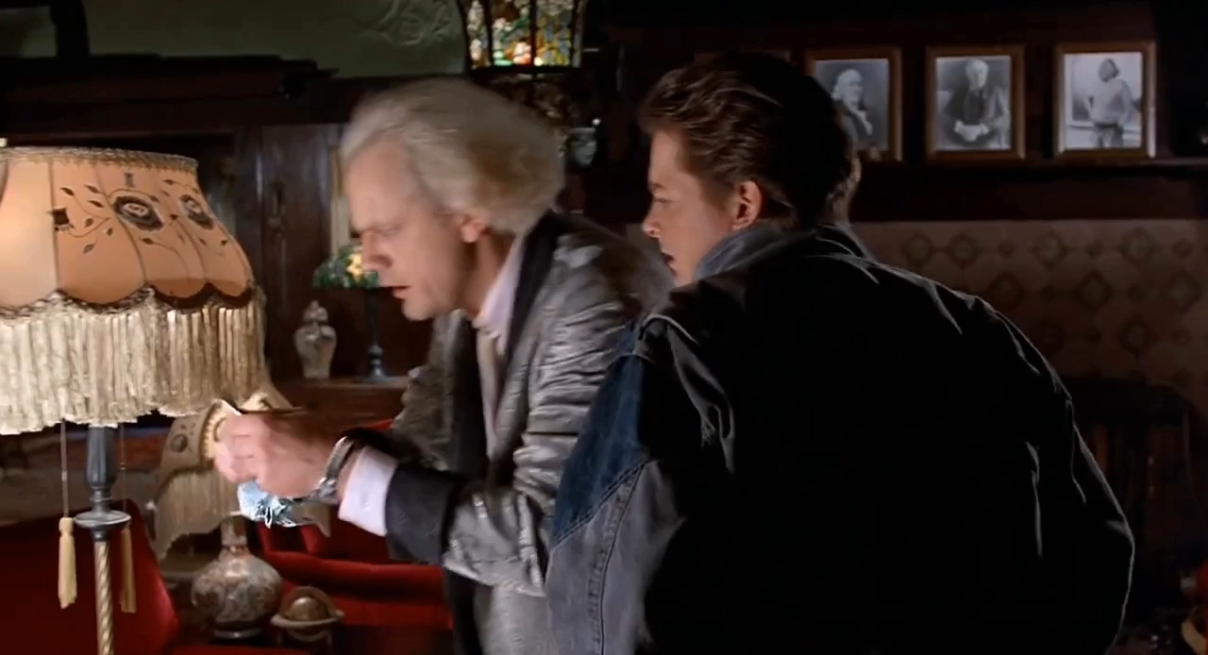
The Greek word “mnemonicide” (neh-MAHN-i-cide) — the deliberate removal of a public memory marker, often carried out by tyrannical regimes to blot their predecessors and opponents from history. - (Schultz 2015 “How Cultures Remember”). The destruction of archives and records is a destruction of the unseen, not of flesh and blood but that of the soul of a people. – (Sleeman 2006 “Cultural Genocide”)
Notes:
The statues were blown up and destroyed in March 2001 by the Taliban, on orders from leader Mullah Mohammed Omar

Slide 6
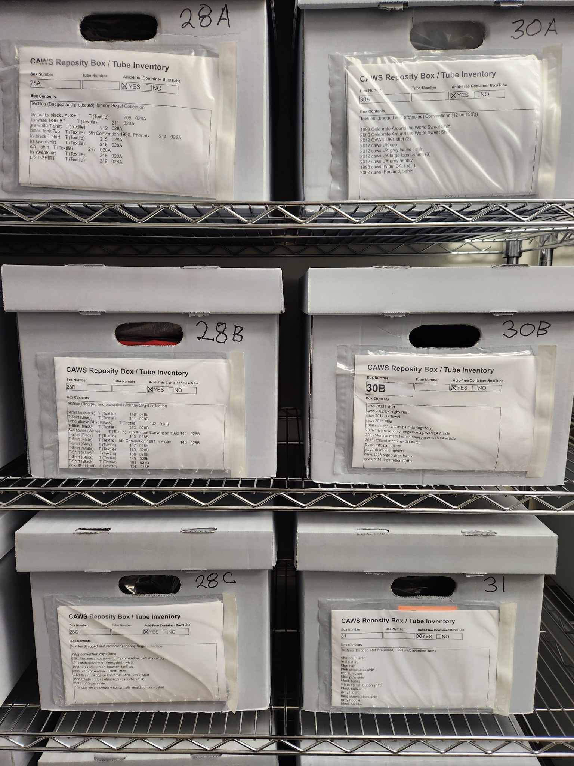
The C.A. World Service Archive Committee collects, preserves, catalogs and curates the historical record of C.A.’s World activities.
Our archives can tell us more about our membership, our committees, our procedures and most importantly how we got from way back when to where we are now, which can have a tremendous bearing on where C.A. headed.
Our C.A. Archive can tell us stories and increases our sense of C.A. identity and helps us to understand of our fellowship, both locally and globally. This dynamic not only focuses our C.A. identity, it also facilitates C.A. Unity.

Slide 7
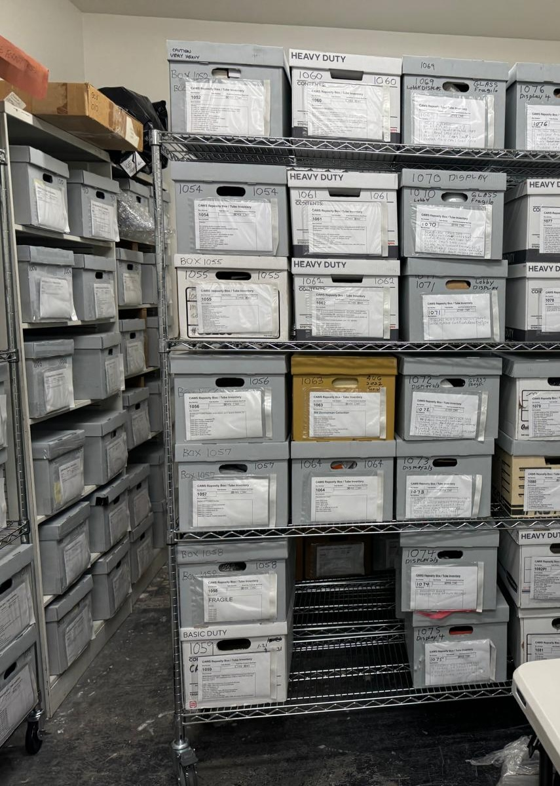
The Archives Committee
of Cocaine Anonymous
We, as a World Service Committee and those of you as Archivists in your respective Areas have done much to collect and preserve C.A.’s history.
C.A. is an expanding global concern and our responsibility to preserve and protect C.A.’s legacy leaves us with much to do.
If you are not already involved in C.A. Service, please consider joining us in the Archives, either at the Group, District, Area or World level and play an integral part in protecting C.A.’s future, by preserving C.A.’s past.

Slide 8
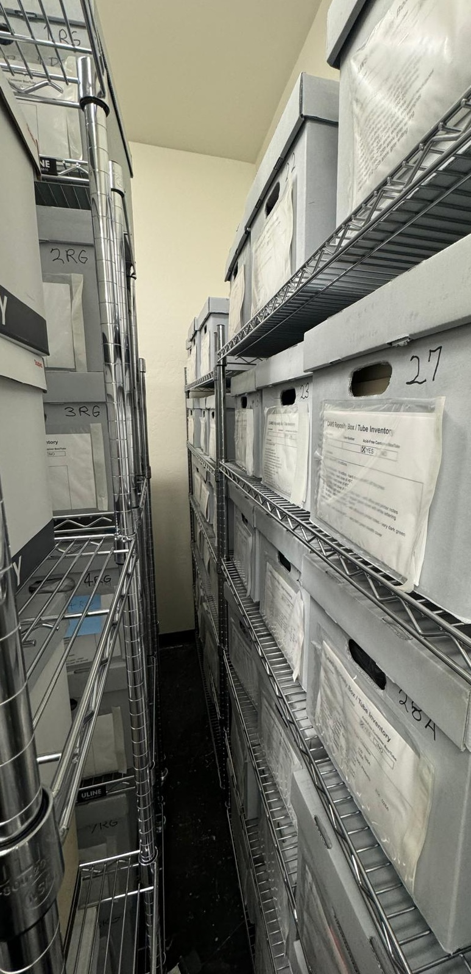
Cocaine Anonymous
Archive Goals
Create District/Area Archive Committees
Develop an archives policy: clearly define its purpose, goals and the type of material it will acquire.
Collect appropriate C.A. material: actively gather records from the District/Area/Group and the C.A. Fellowship at large.
Be responsible for the archival holdings: know what material is in the archives and where it came from; storing the archives properly and securing it against theft, damage, and environmental or human hazards.
Make archival materials available for use by the C.A. fellowship.

Slide 9
Cocaine Anonymous Chronology
The Early Days
Los Angeles, California 1982
'If you truly want to understand the present, or yourself, you must begin in the past. You see, history is not simply the study of the past. It is an explanation of the present.' - Paul Hunham (The Holdovers 2023)

Slide 10
Earliest Appearance of Cocaine Anonymous
October 12, 1979 is the earliest known date for the name “Cocaine Anonymous” was used by a New York drug counsellor, John Burrell, who launched a special treatment group for coke users calling it “Cocaine Anonymous.” (Albany Student Press, October 12, 1979. p. 9)
Later, on November 20, 1979, on WBAB Radio with Joel Martin, the topic of discussion is Cocaine Anonymous and John Burell is featured as the founder of Cocaine Anonymous. (Newsday Nov. 20, 1979. p. 104).

Slide 11
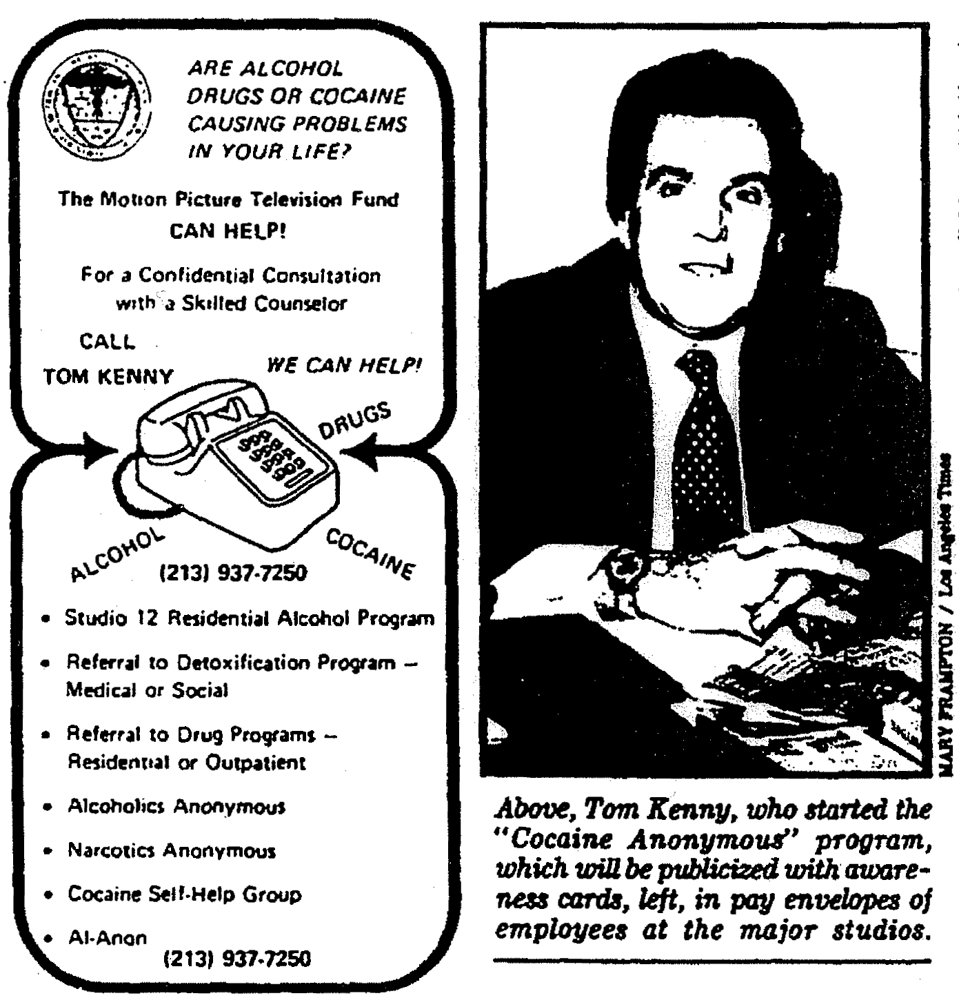
In the Beginning: Los Angeles, November 1982
Tom K ., the owner of an "entertainment industry sober living facility called " Studio 12" identifies the need for a group for cocaine-addicted people to talk about their struggles and sobriety.
In November 1982, Johnny S. who has been sober through the Motion Picture Recovery House in the Valley gets a call from Tom K., the Director of the Motion Picture and Television Fund's alcoholism and drug program.
Tom K. plans to host an AA Meeting for addicts, specifically cocaine addicts, at the Motion Picture Fund in Hollywood, California” because if you go to AA meetings and talked about drugs, they asked you to leave.”

Slide 12
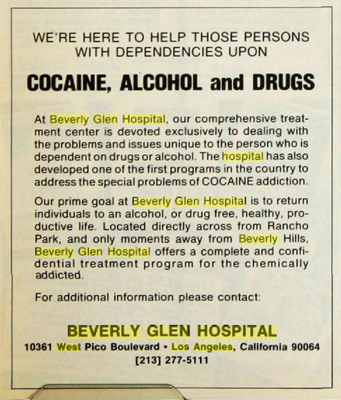
To advertise its new program to combat cocaine addiction, the Beverly Glen Hospital in West Los Angeles took out ads (Billboard, Aug. 22, 1982) in the entertainment trade publications, such as Billboard, The Hollywood Reporter and Daily Variety, as well as the Westside edition of The Times.
Working at the Beverly Glen Hospital, Psychotherapist Allan Rosenthal called cocaine “the most psychologically devastating” drug and developed a voluntary $7000 – 21 day program, which included detoxification, drug education and intensive individual and group therapy. By the fall 1982, the program has 17 adults and six adolescent in-patients. Rosenthal said the hospital offers one of the most specialized treatment programs against cocaine addiction in the nation, he stressed that in-patient treatment offers no guarantee of permanent recovery. In fact, he said, the long-term recovery rate of cocaine abusers “is so small that I will not work with anybody privately unless at the end of the first month of treatment” they join an ongoing self-help group such as A.A.
(LA Times, Dec. 26, 1982 p. 208)
Late Summer of 1982
The Beverly Glen Hospital
Los Angeles, CA

Slide 13
1st H&I Meeting at the Beverly Glen Hospital Meeting
In the late fall of 1982, Allan Rosenthal suggests to Chip P. to start a 12 Step “Cocaine Anonymous” meeting at the Beverly Glen Hospital. Chip rewords some A.A. preambles and changes them to Cocaine Anonymous and asks his friend, Bobby N. to be the first C.A. speaker. In addition, the Beverly Glen hospital provided a room for the weekly, free “Cocaine Anonymous” meeting which was open to drug abusers. The hospital also provided a small room with an answering machine for taking inquires about getting help with cocaine abuse. Chip P. stated that this was really the first central office for early Cocaine Anonymous.
By December of 1982, the group averages 30 people in attendance. Allan Rosenthal said the response from doctors and other health-care professionals has been “so overwhelming” that he envisions a mushrooming “Cocaine Anonymous” organization in Los Angeles, complete with a telephone hotline, literature and an administrative office.
In the fall of 1982 (date unknown) Tom Kenny, director of alcoholism services for the Motion Picture and Television Fund, a charitable organization supported by contributions from people who work in films and TV, approaches Allan Rosenthal and inquires about the Beverly Glen Hospital program for the treatment of cocaine addiction and wanted to know more about the program and Allan’s approach to recovery.

Slide 14
First C.A. Meeting: November 18, 1982
Tuesday, November 16, 1982 – Nineteen "sober men and women" attend the “Whatever” meeting of AA to talk about cocaine. After the meeting Johnny S. and several other attendees meet and decide to start a Thursday night meeting and call it Cocaine Anonymous.
Thursday, November 18, 1982, with 12 people in attendance the first meeting of C.A. takes place in Los Angeles [Hollywood], California. Veronica is the secretary and calls the meeting to order with a gavel and announces:
"Welcome to the first meeting of Cocaine Anonymous, a fellowship of men and women who share their experience, strength, and hope with each other and help others recover from their addiction.”

Slide 15
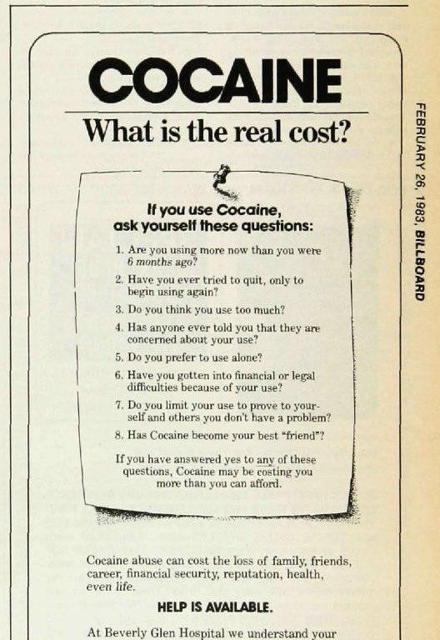
2nd C.A. Meeting
Our 1st H&I Meeting
The Beverly Glen Hospital had closed meetings on Wednesday nights only for patients, using the name, Cocaine Anonymous.
After the first November 1982 C.A. meeting took place, Beverly Glen opened their meeting on Wednesdays to everyone. Within a week of starting, there were two Cocaine Anonymous Meetings by the end of Nov. 1982.

Slide 16
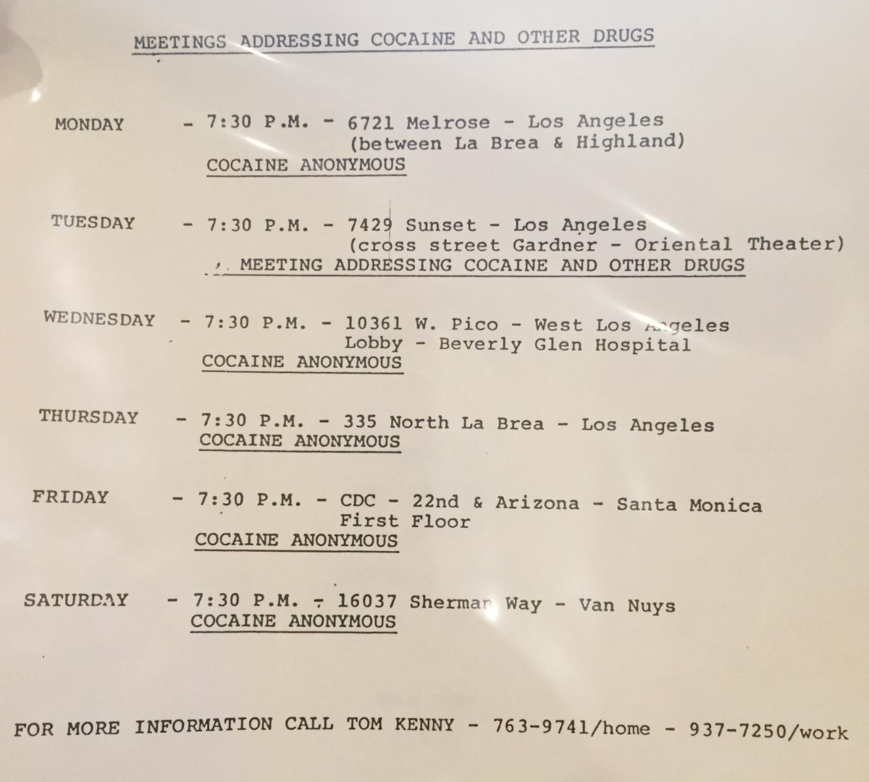
Early 1982-1983 Meeting List
Pictured Right: An early Tom K. C.A. Meeting List
*Note: The Tuesday meeting is the A.A. “Whatever Group.” Tom K., an A.A. member, is a “strong help” to the budding C.A. group.
Tom helps to the early C.A. fellowship find rooms for meetings, set up work committees and shows the C.A. members how to do a directory and get things organized.

Slide 17
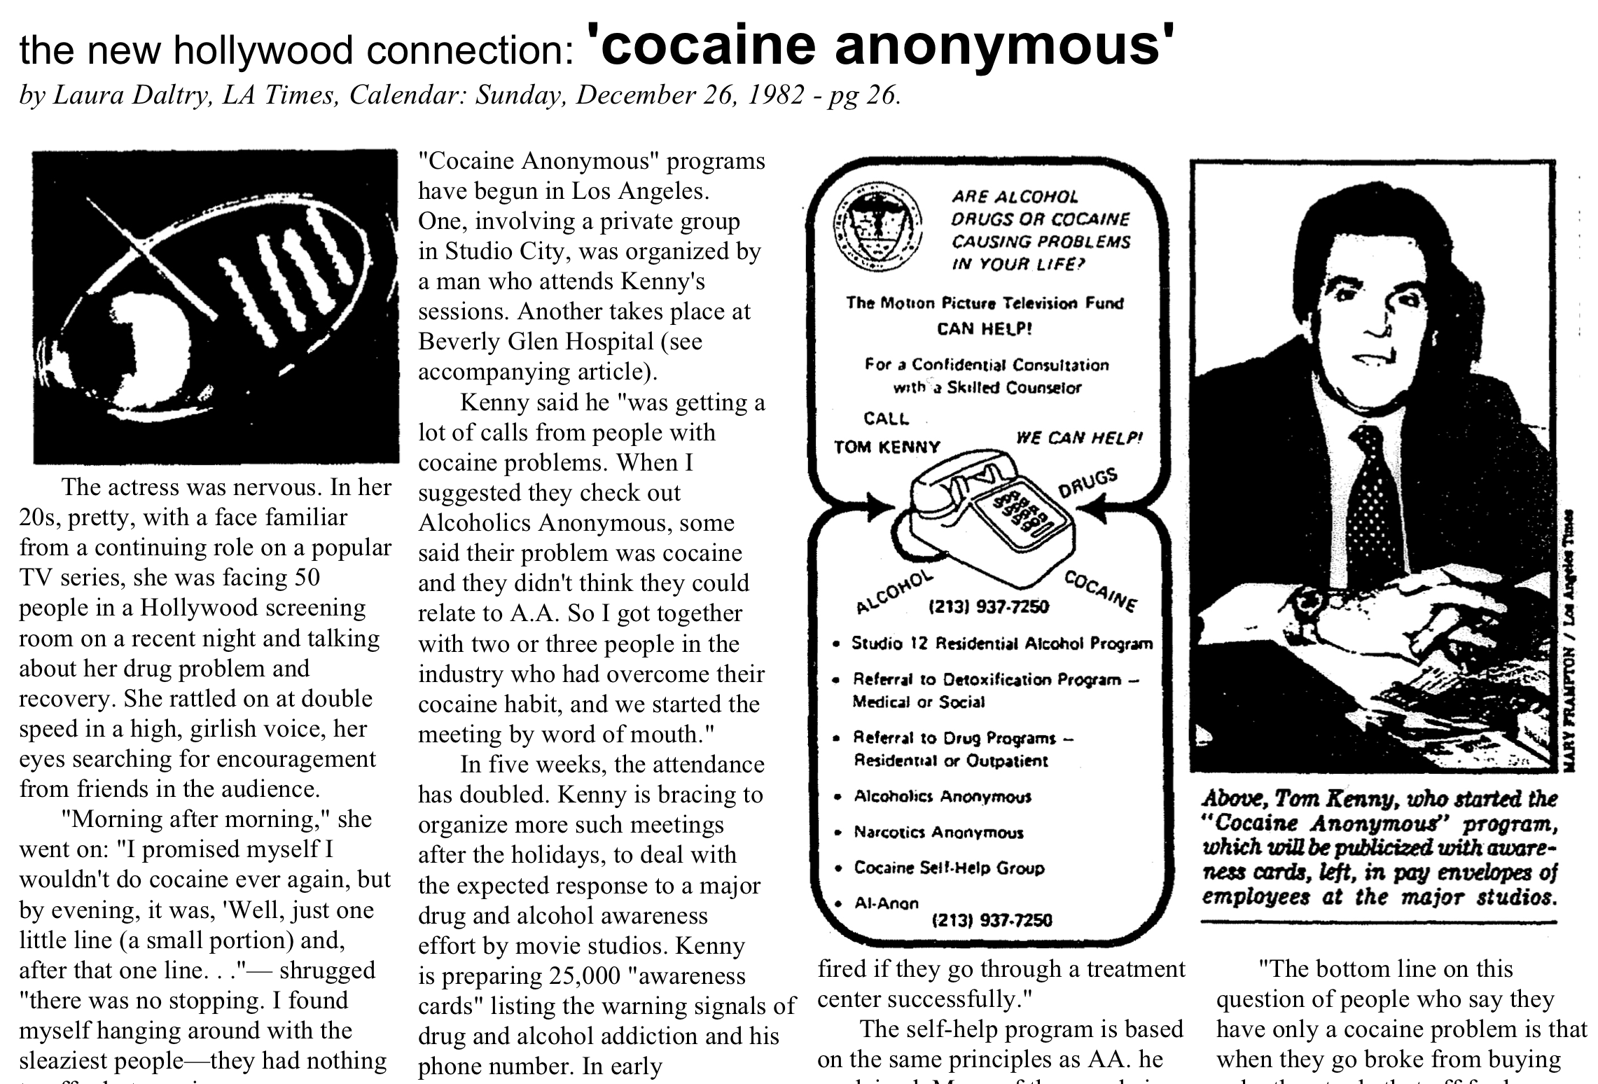
First C.A. Media Story
LA Times, Calendar: Sunday December 26, 1982

Slide 18
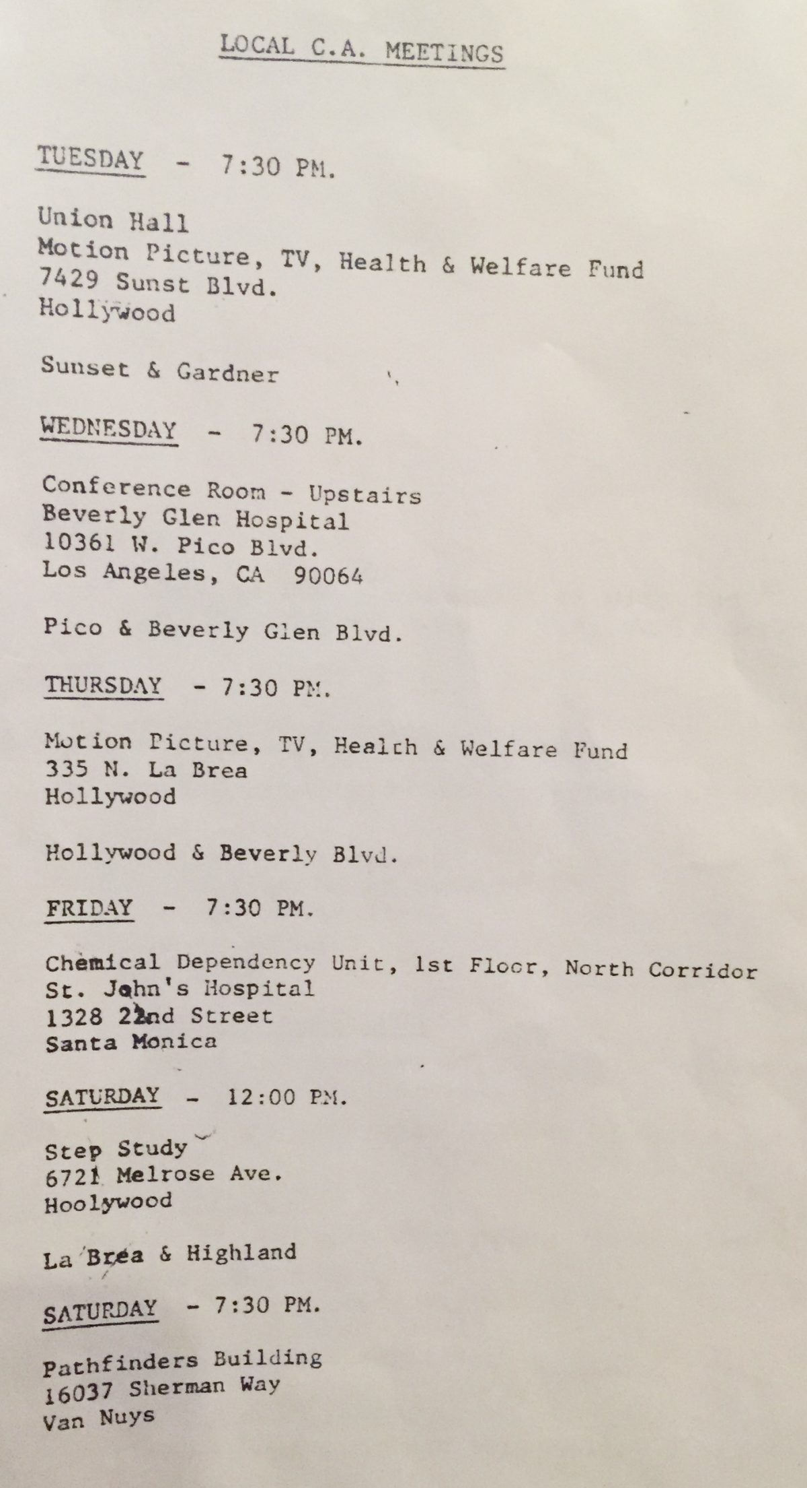
1983 Initial C.A. Organization
February 1983 – The secretaries of the six C.A. meetings got together and formed what eventually became the first General Services Organization.
Ray G. is in charge of the Cocaine Anonymous phone number. It rings on an answering machine in a small Beverly Glen Hospital room and Ray G. returns all calls. The room and phone machine are provided by Beverly Glen Hospital.
Ray G. manages the hotline for the first year. “If any of you called in the first year of existence of Cocaine Anonymous and talked to the man on the telephone, that was Ray because he took all the calls for the first year of Cocaine Anonymous.”
Pictured Right: Early Ray G. Meeting List *Note the Tuesday Meeting is the A.A. Whatever Meeting.

Slide 19
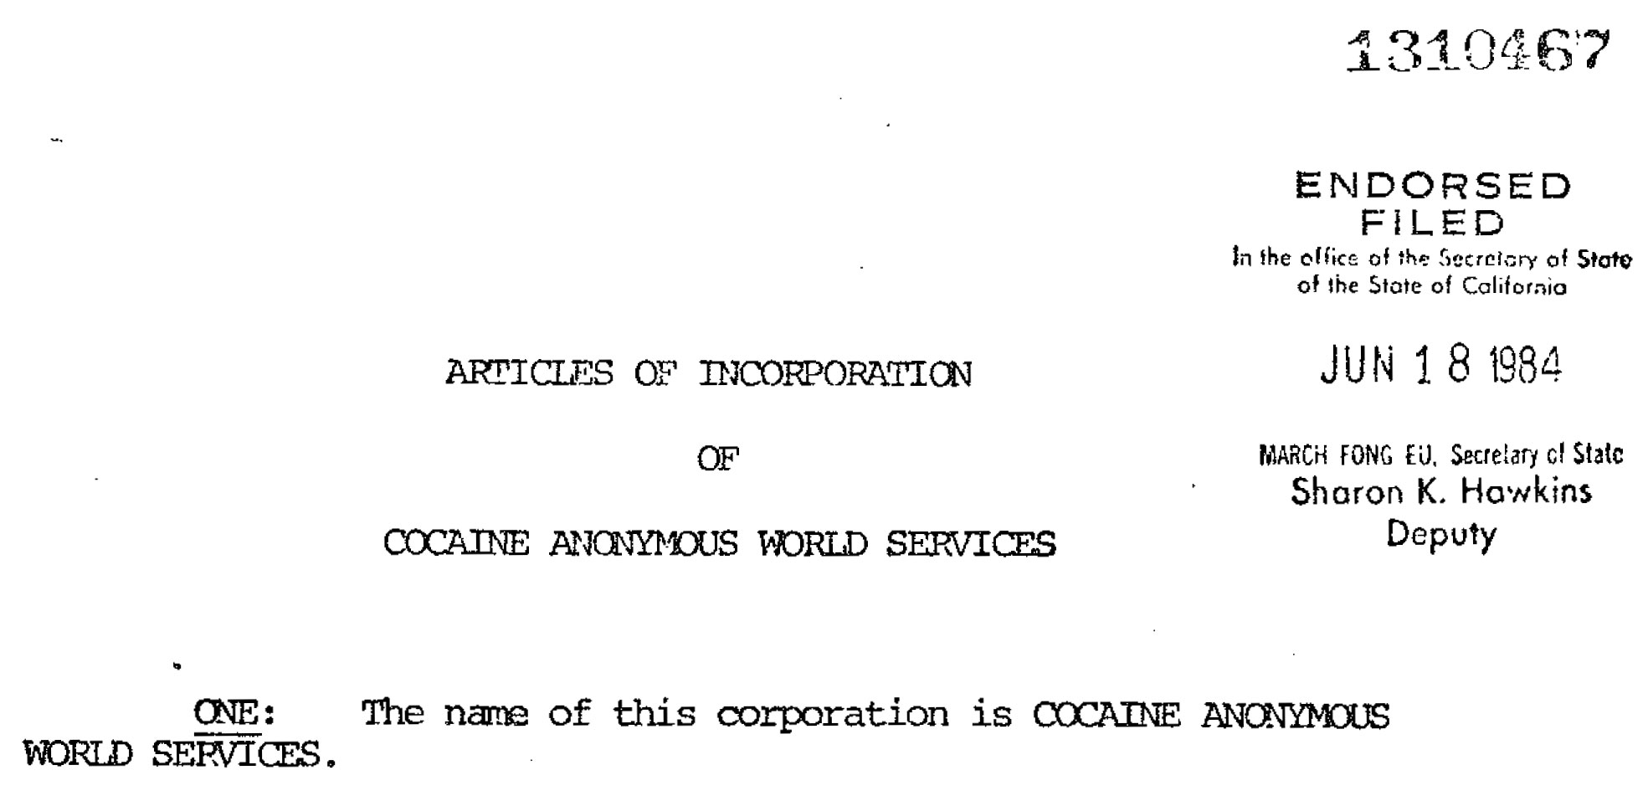
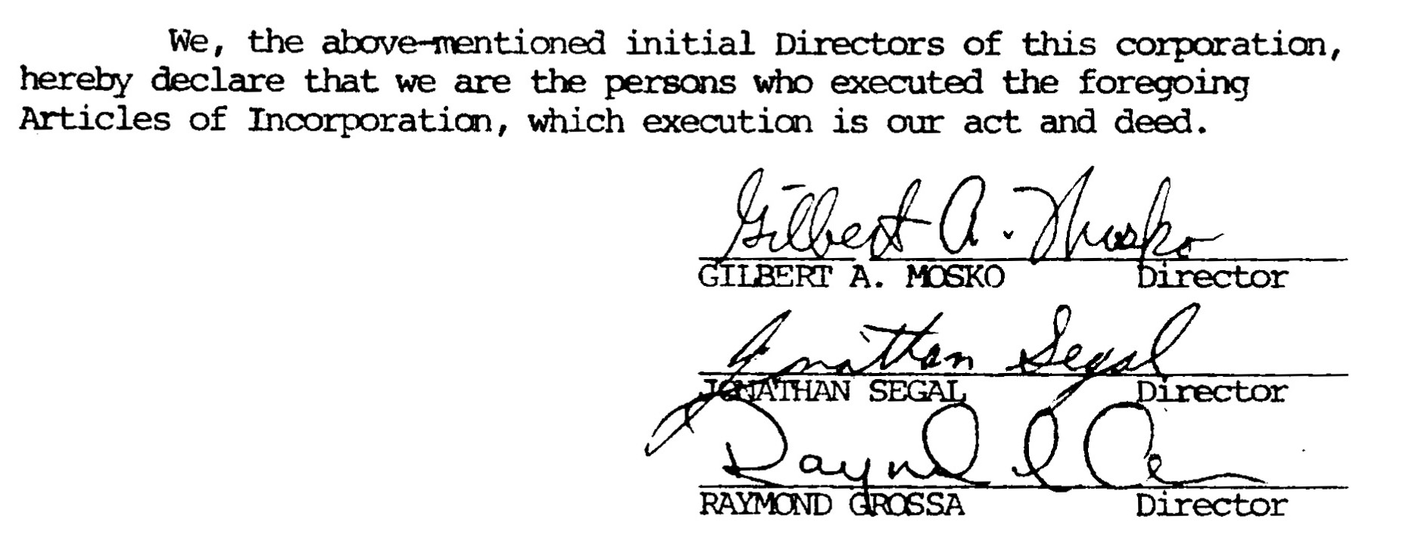
Cocaine Anonymous World Services
Non-profit corporation effective June 18, 1984
In the beginning, C.A. was “Cocaine Anonymous of Los Angeles.” But, due to the number of C.A. fellowships emerging across the country in the first two years, it was decided that a guiding organization for the country was needed.
In 1984 “Cocaine Anonymous World Services” was created. They retained a lawyer to expedite forming a non-profit corporation. The elected 3 trustees (Ray Grossa, Gil Mosko, and Jonathan Segal) and created an office board of a number of people.

Slide 20
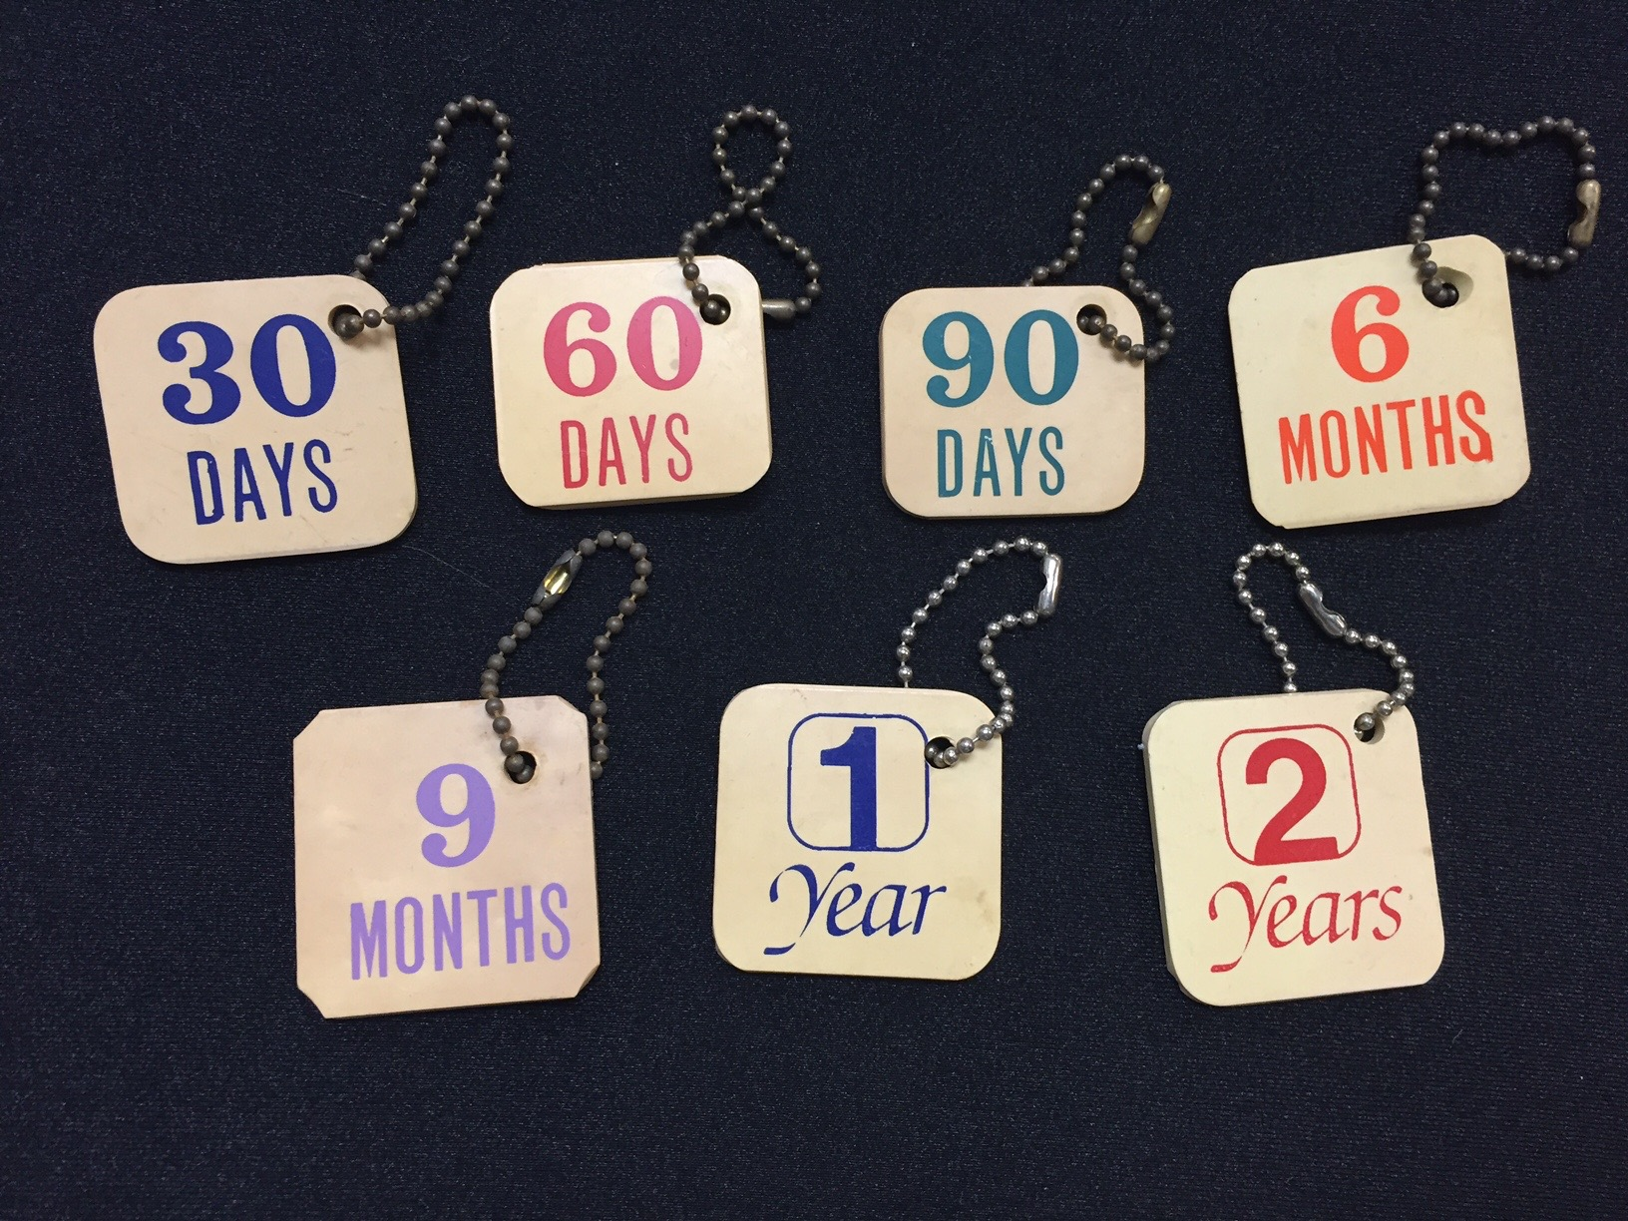
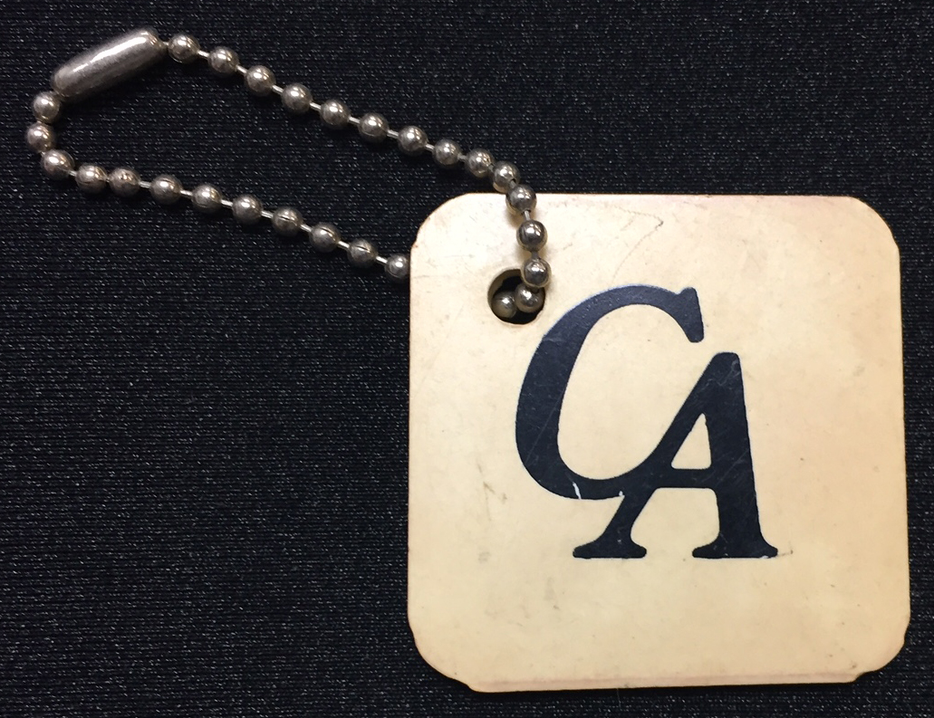
1st C.A. Chips - 1983
C.A. Chips were created with the hope that they would be a unifying factor in the young fellowship.
Unfortunately, the hard, white square chip with letters and numbers would easily wear off and relapsing addicts would use them to chop cocaine.
Business meetings occurred every Tuesday night at the home of Johnny S. (May/June 1983) to work on public information, phone lines, formats, steps, traditions, chips, and logo. Meetings go on for hours.

Slide 21
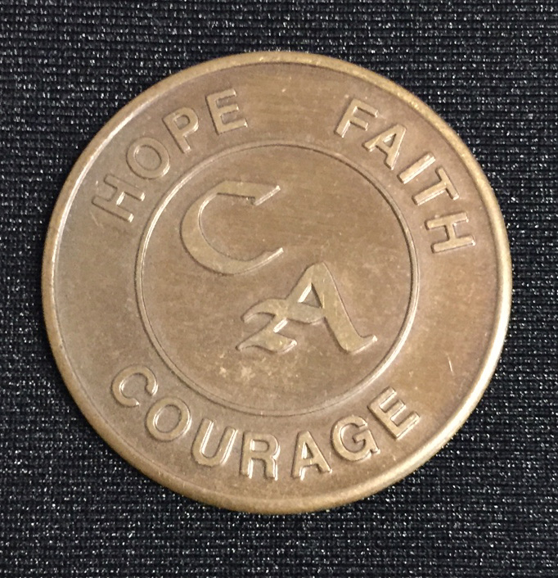
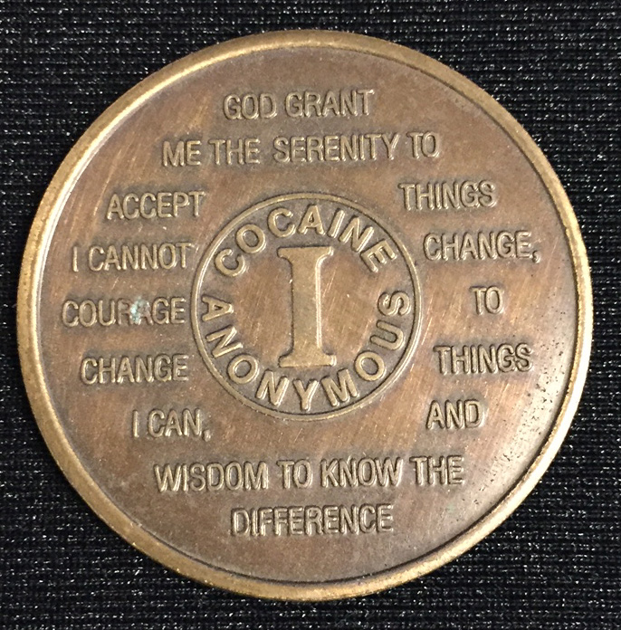
Early C.A. Metal Sobriety Coin
N. California “Calligraphy” Font
1 Year - Roman Numeral
Johnny S. was asked to come up with three words to epitomize the spirit of Cocaine Anonymous. Originally it was “Hope, Faith and Willingness.” But “Willingness” was too long. At the time, Johnny was listening to a speech by John F. Kennedy about having courage to do difficult things in your life. Johnny decided that the word “Courage” was appropriate because it fit nicely in the circle, and he felt “it took courage to walk into the doors of C.A.”

Slide 22

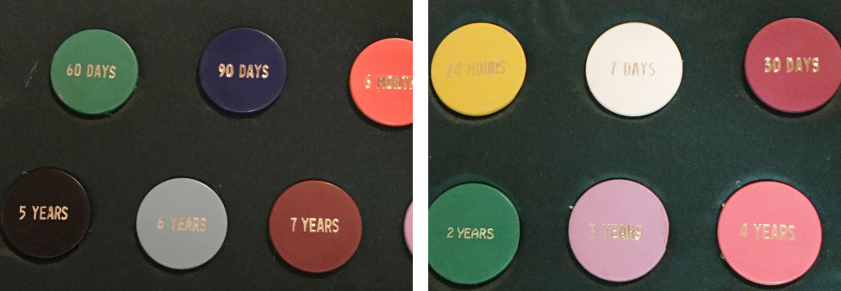
Early C.A. Northern California Sobriety Chips
Since Northern California had the first metal chip, the chip company would not make chips for C.A. World Service. In 1987 Northern California deeded to C.A. World Services the right to make metal chips with the C.A. logo that was voted on in 1986 first World Service Conference.

Slide 23
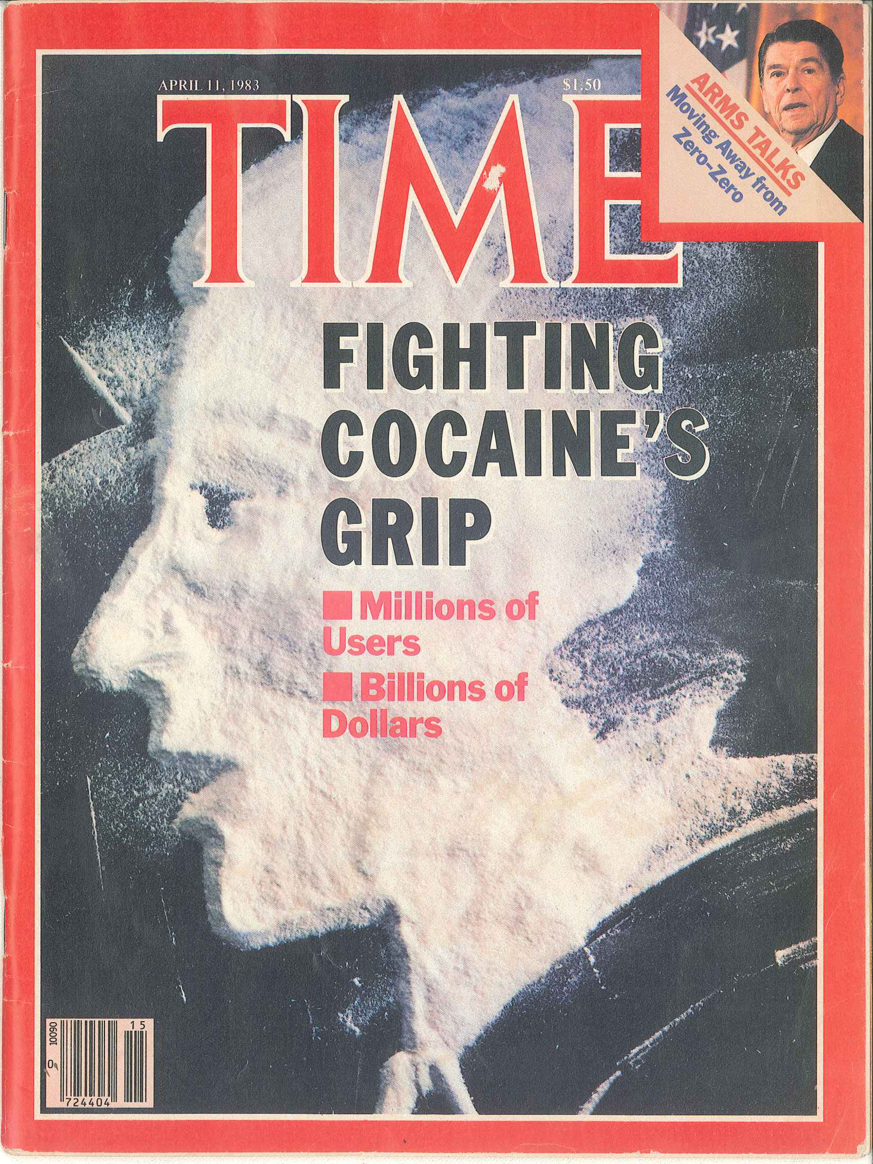
Early C.A. Media Hype
April 11, 1983, Time Magazine Cover features a story on fighting cocaine’s grip on millions of users. The article references Cocaine Anonymous…”In Los Angeles, new Cocaine Anonymous groups draw 700 people to weekly meetings.”

Slide 24
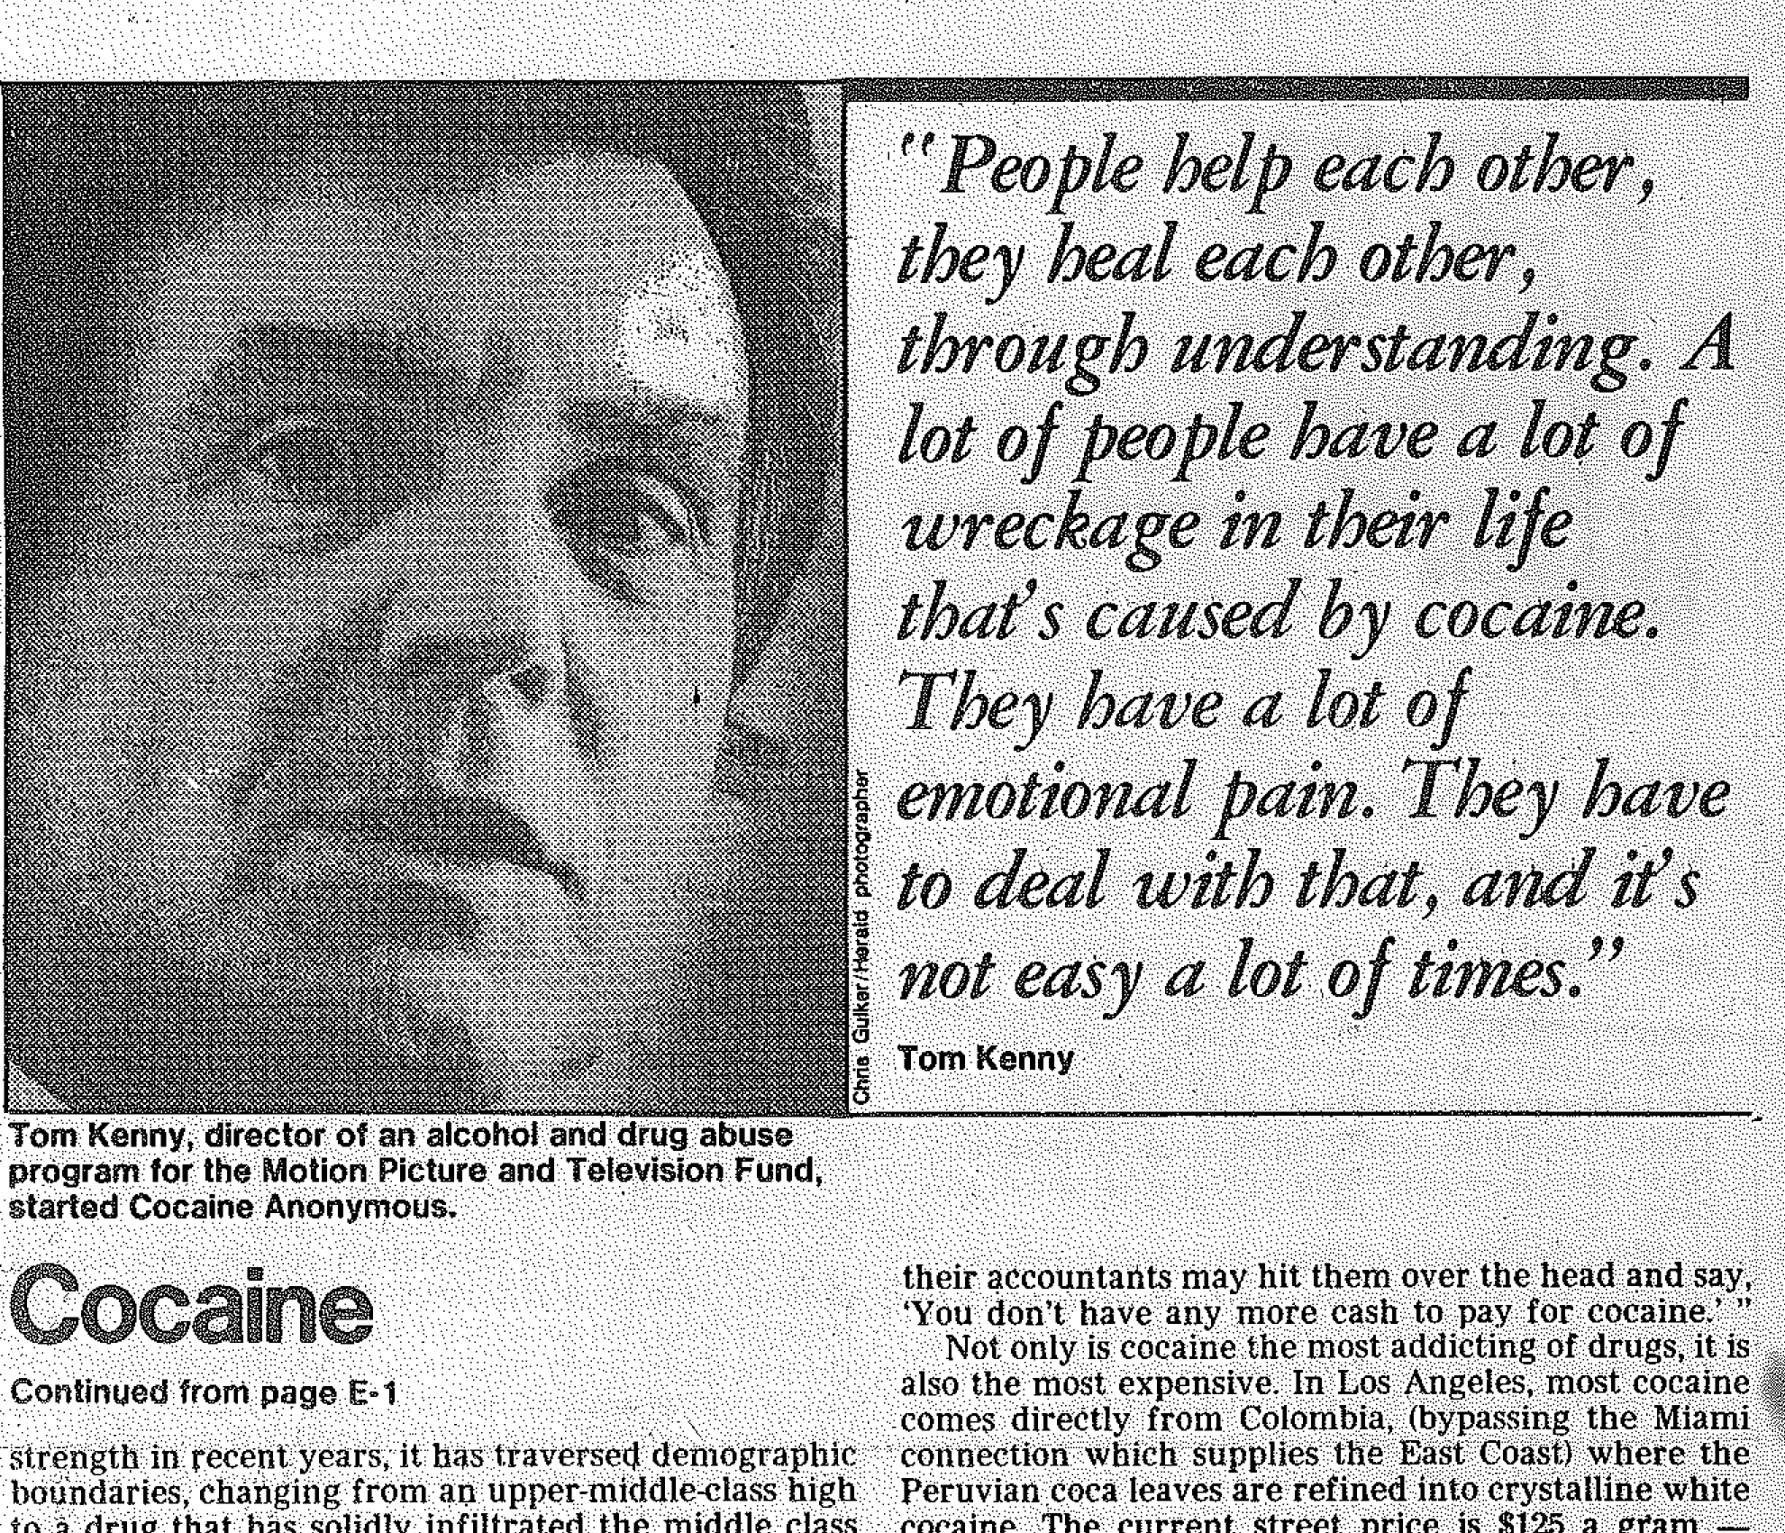
Media awareness and public information
was vital to the early growth of C.A.
May 8, 1983, The Los Angeles Herald Examiner publishes an extensive article on cocaine abuse in the canyons of Beverly Hills and the streets of South Central L.A. The article highlights the good works of Cocaine Anonymous.

Slide 25
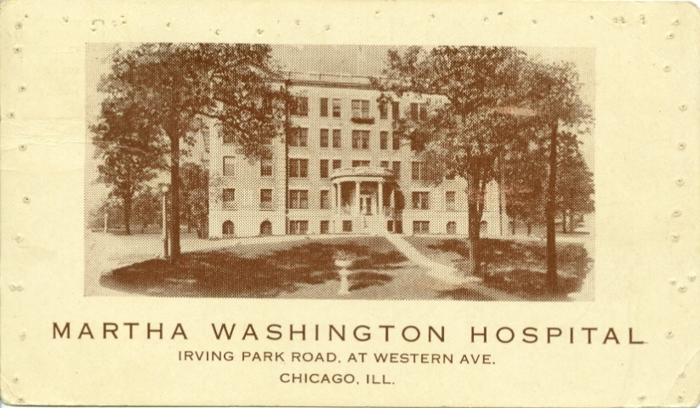
Chicago C.A. Inception – 1st Meeting
Thursday, May 5, 1983

Slide 26
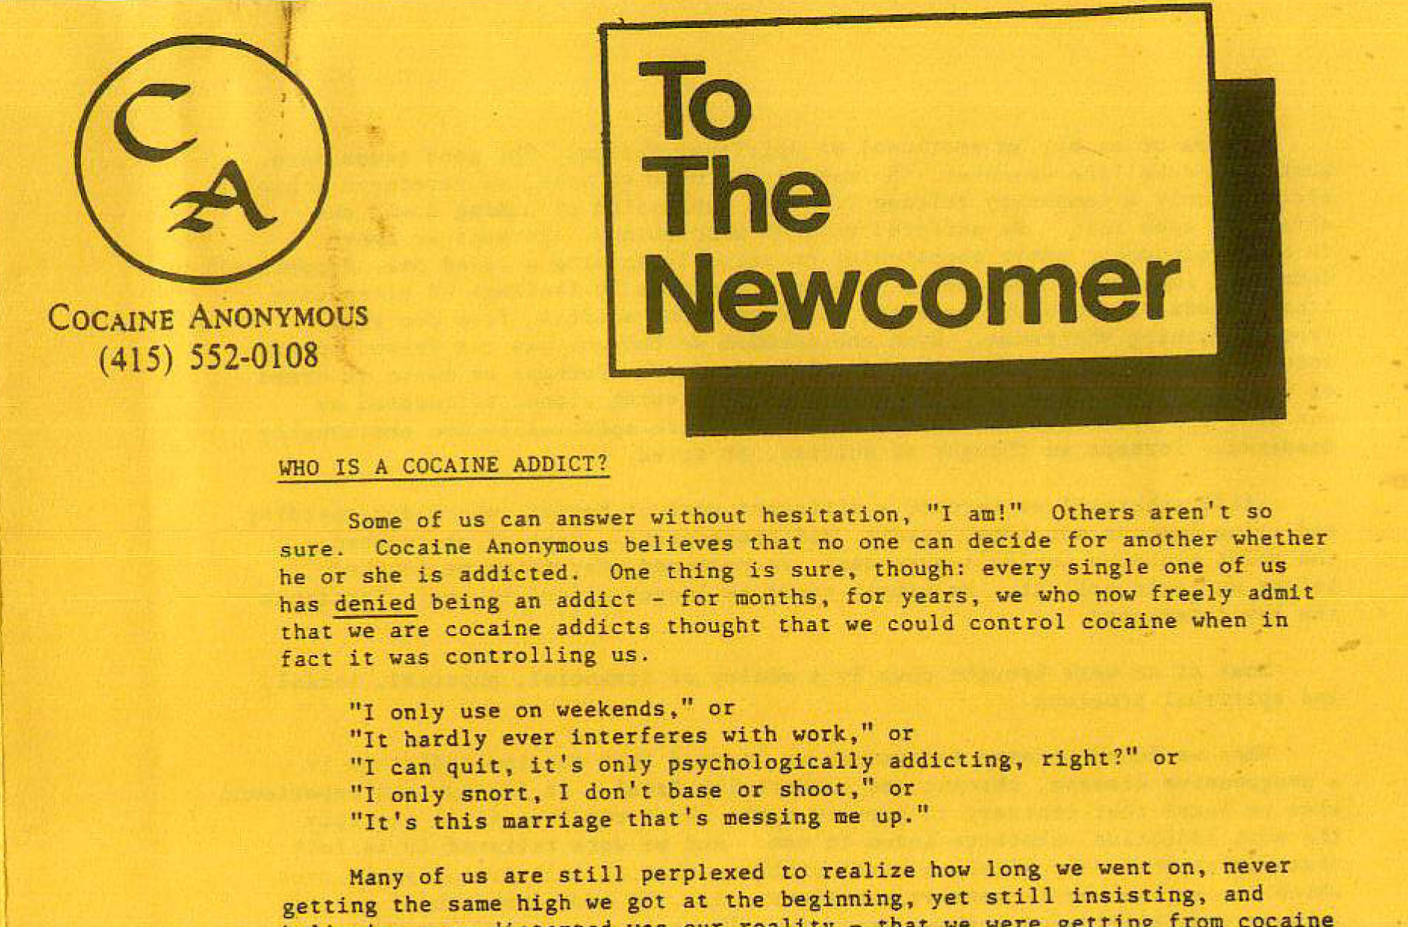
Chicago C.A. Inception – 1st Meeting
Thursday, May 5, 1983
Tony S., and Greg D., original C.A. Members of Chicago, gets the first meeting going at the Martha Washington Hospital.
There was a recovery center in the hospital and Tony was given a room for an answering machine and phone number for the beginnings of Chicago C.A. Then a second meeting soon afterwards started on Tuesday night.
Tony S. (Chicago C.A.), was responsible for writing the 1st draft of, “To The Newcomer” (1st C.A. Pamphlet) and “Who is a Cocaine Addict?”
The fellowship in Los Angeles loved the piece, “To The Newcomer,” and it was immediately incorporated it into C.A. Meetings and Starter Kits. This piece of literature is still with us today. And it has never been changed.

Slide 27
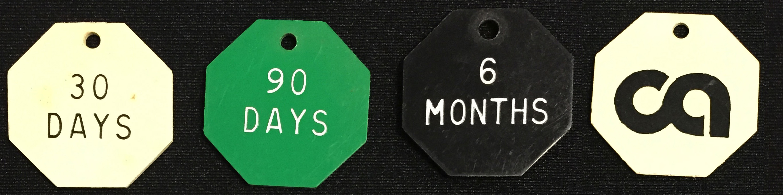
Early C.A. Chicago 1983-1986 Prototype Octagonal Sobriety Chips
The Octagonal Shape of Chicago’s Sobriety Chip was chosen because it replicates a “traffic stop sign” signifying the amount of time a C.A. Member had “stopped” using cocaine. The early “C.A.” logo (pictured right) was designed by Randy R. of Chicago.

Slide 28
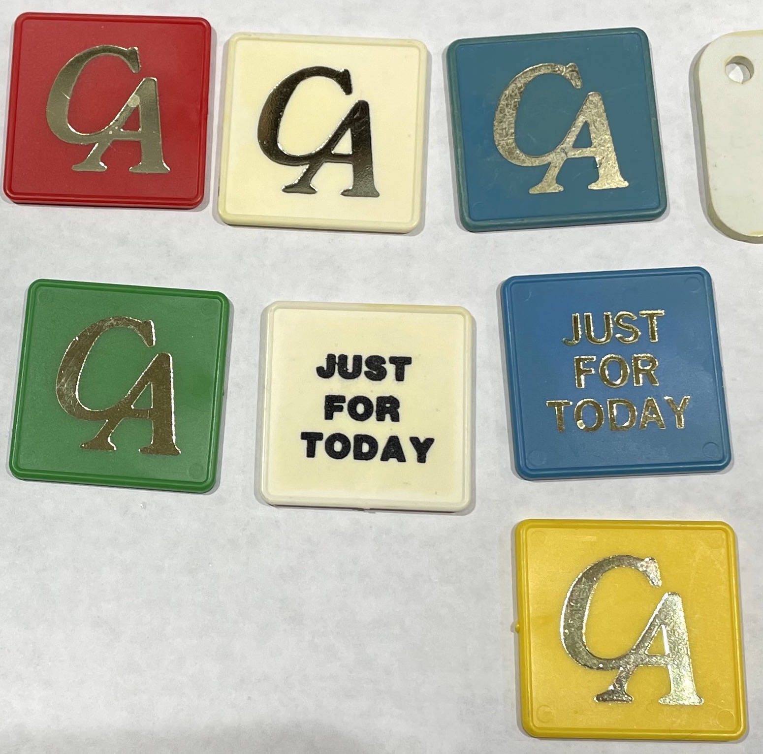
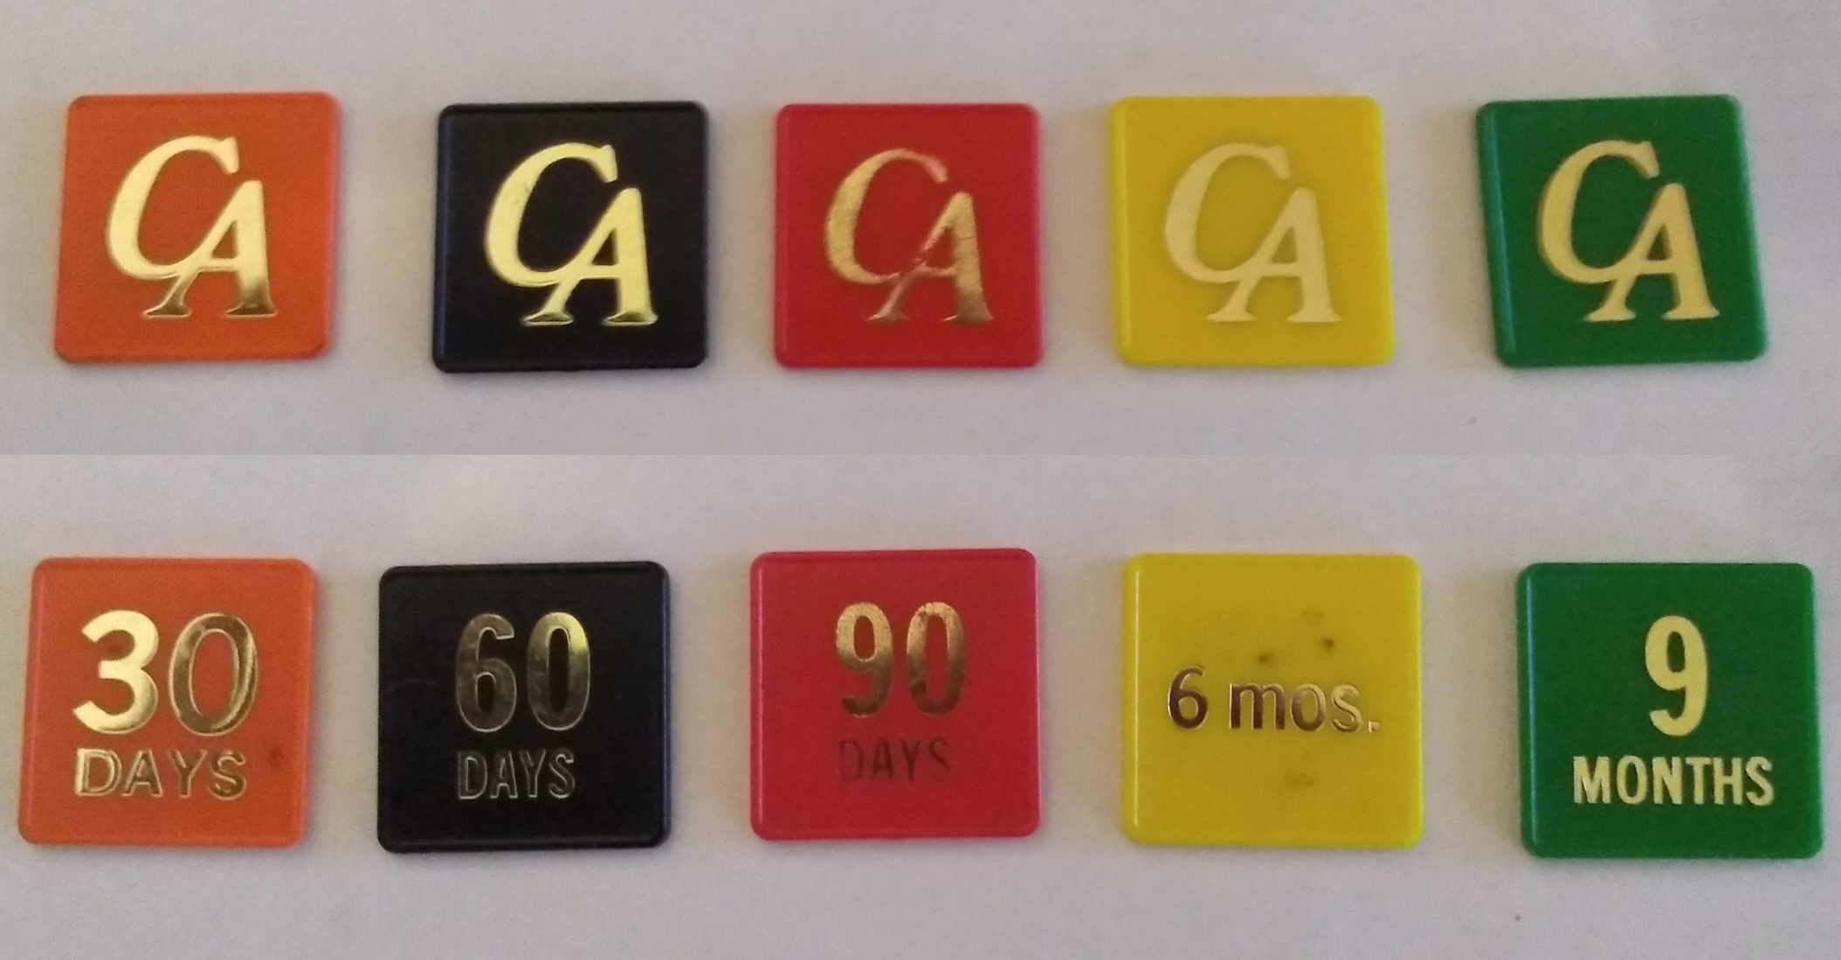
Early C.A. Atlanta, Georgia Sobriety Chips - 1985 - 1986
Atlanta, Georgia had their own sobriety chips too. When Georgia was ratified as an Area at the 1st World Conference Feb. 8,9, 1986, it was agreed that they would buy their sobriety chips from World Services in L.A.

Slide 29
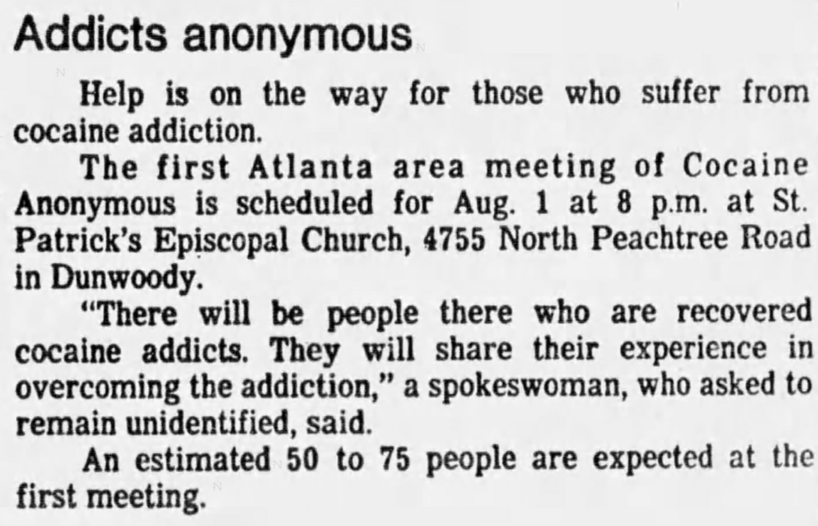
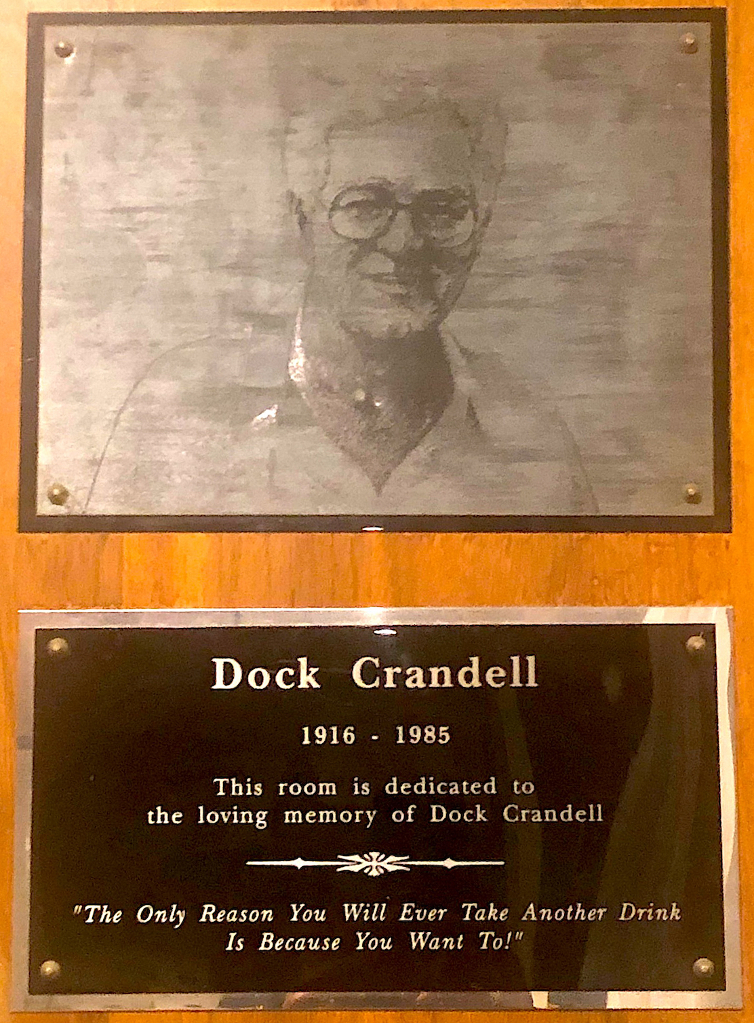
The Early Days of C.A. in Atlanta, Georgia
The Atlanta Constitution, Thursday, July 28, 1983, p. 26
According to Leon K.,Dock Crandall, an A.A. member brought C.A. from California to Atlanta, Georgia in August of 1983 because many of his prospects were "cocaine junkies."
According to Leon K., says "Dock" was killed accidentally on a 12 Step call to one of his sponsees who had relapsed and was going to commit suicide with a shotgun. "Dock" tried to intervene and the shotgun accidentally discharged killing "Dock" November 26, 1985.

Slide 30
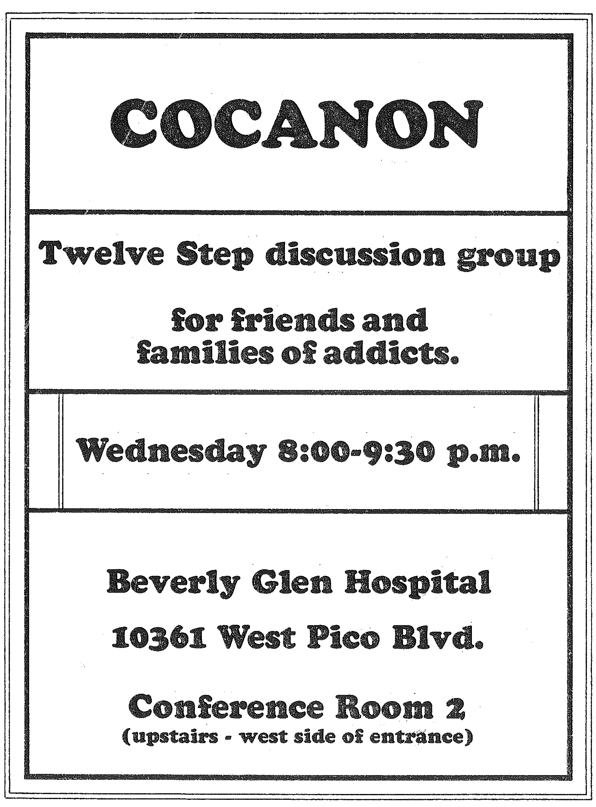
Coc-Anon | Co-Anon 1983
Co-Anon was started by Johnny S.’s wife, Janine P. It was initially named Coc-Anon.
Johnny S. reported his wife would get upset with him about having the meetings at their home all the time and Johnny S. suggests that C.A. needs a group like Al-Anon and that she should start it.
Sometime during the second year of C.A., she did.

Slide 31
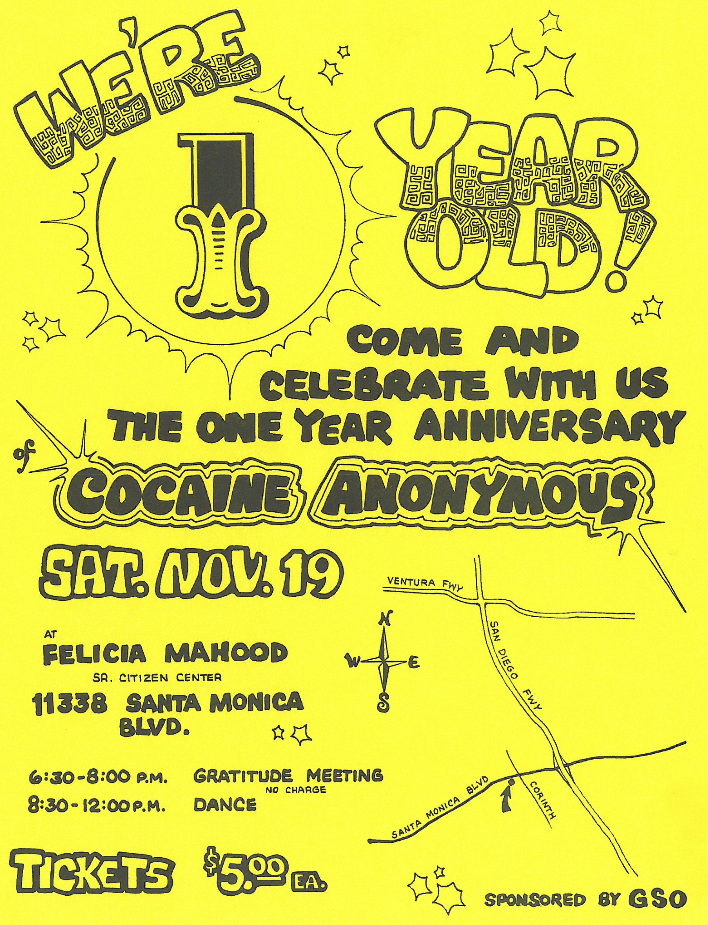
1st Year C.A. Anniversary November 1983
January 3, 1984 – Santa Cruz Sentinel publishes Cocaine Anonymous just like Alcoholics Anonymous. One year after inception, C.A. in Southern California has more than 2000 members.

Slide 32
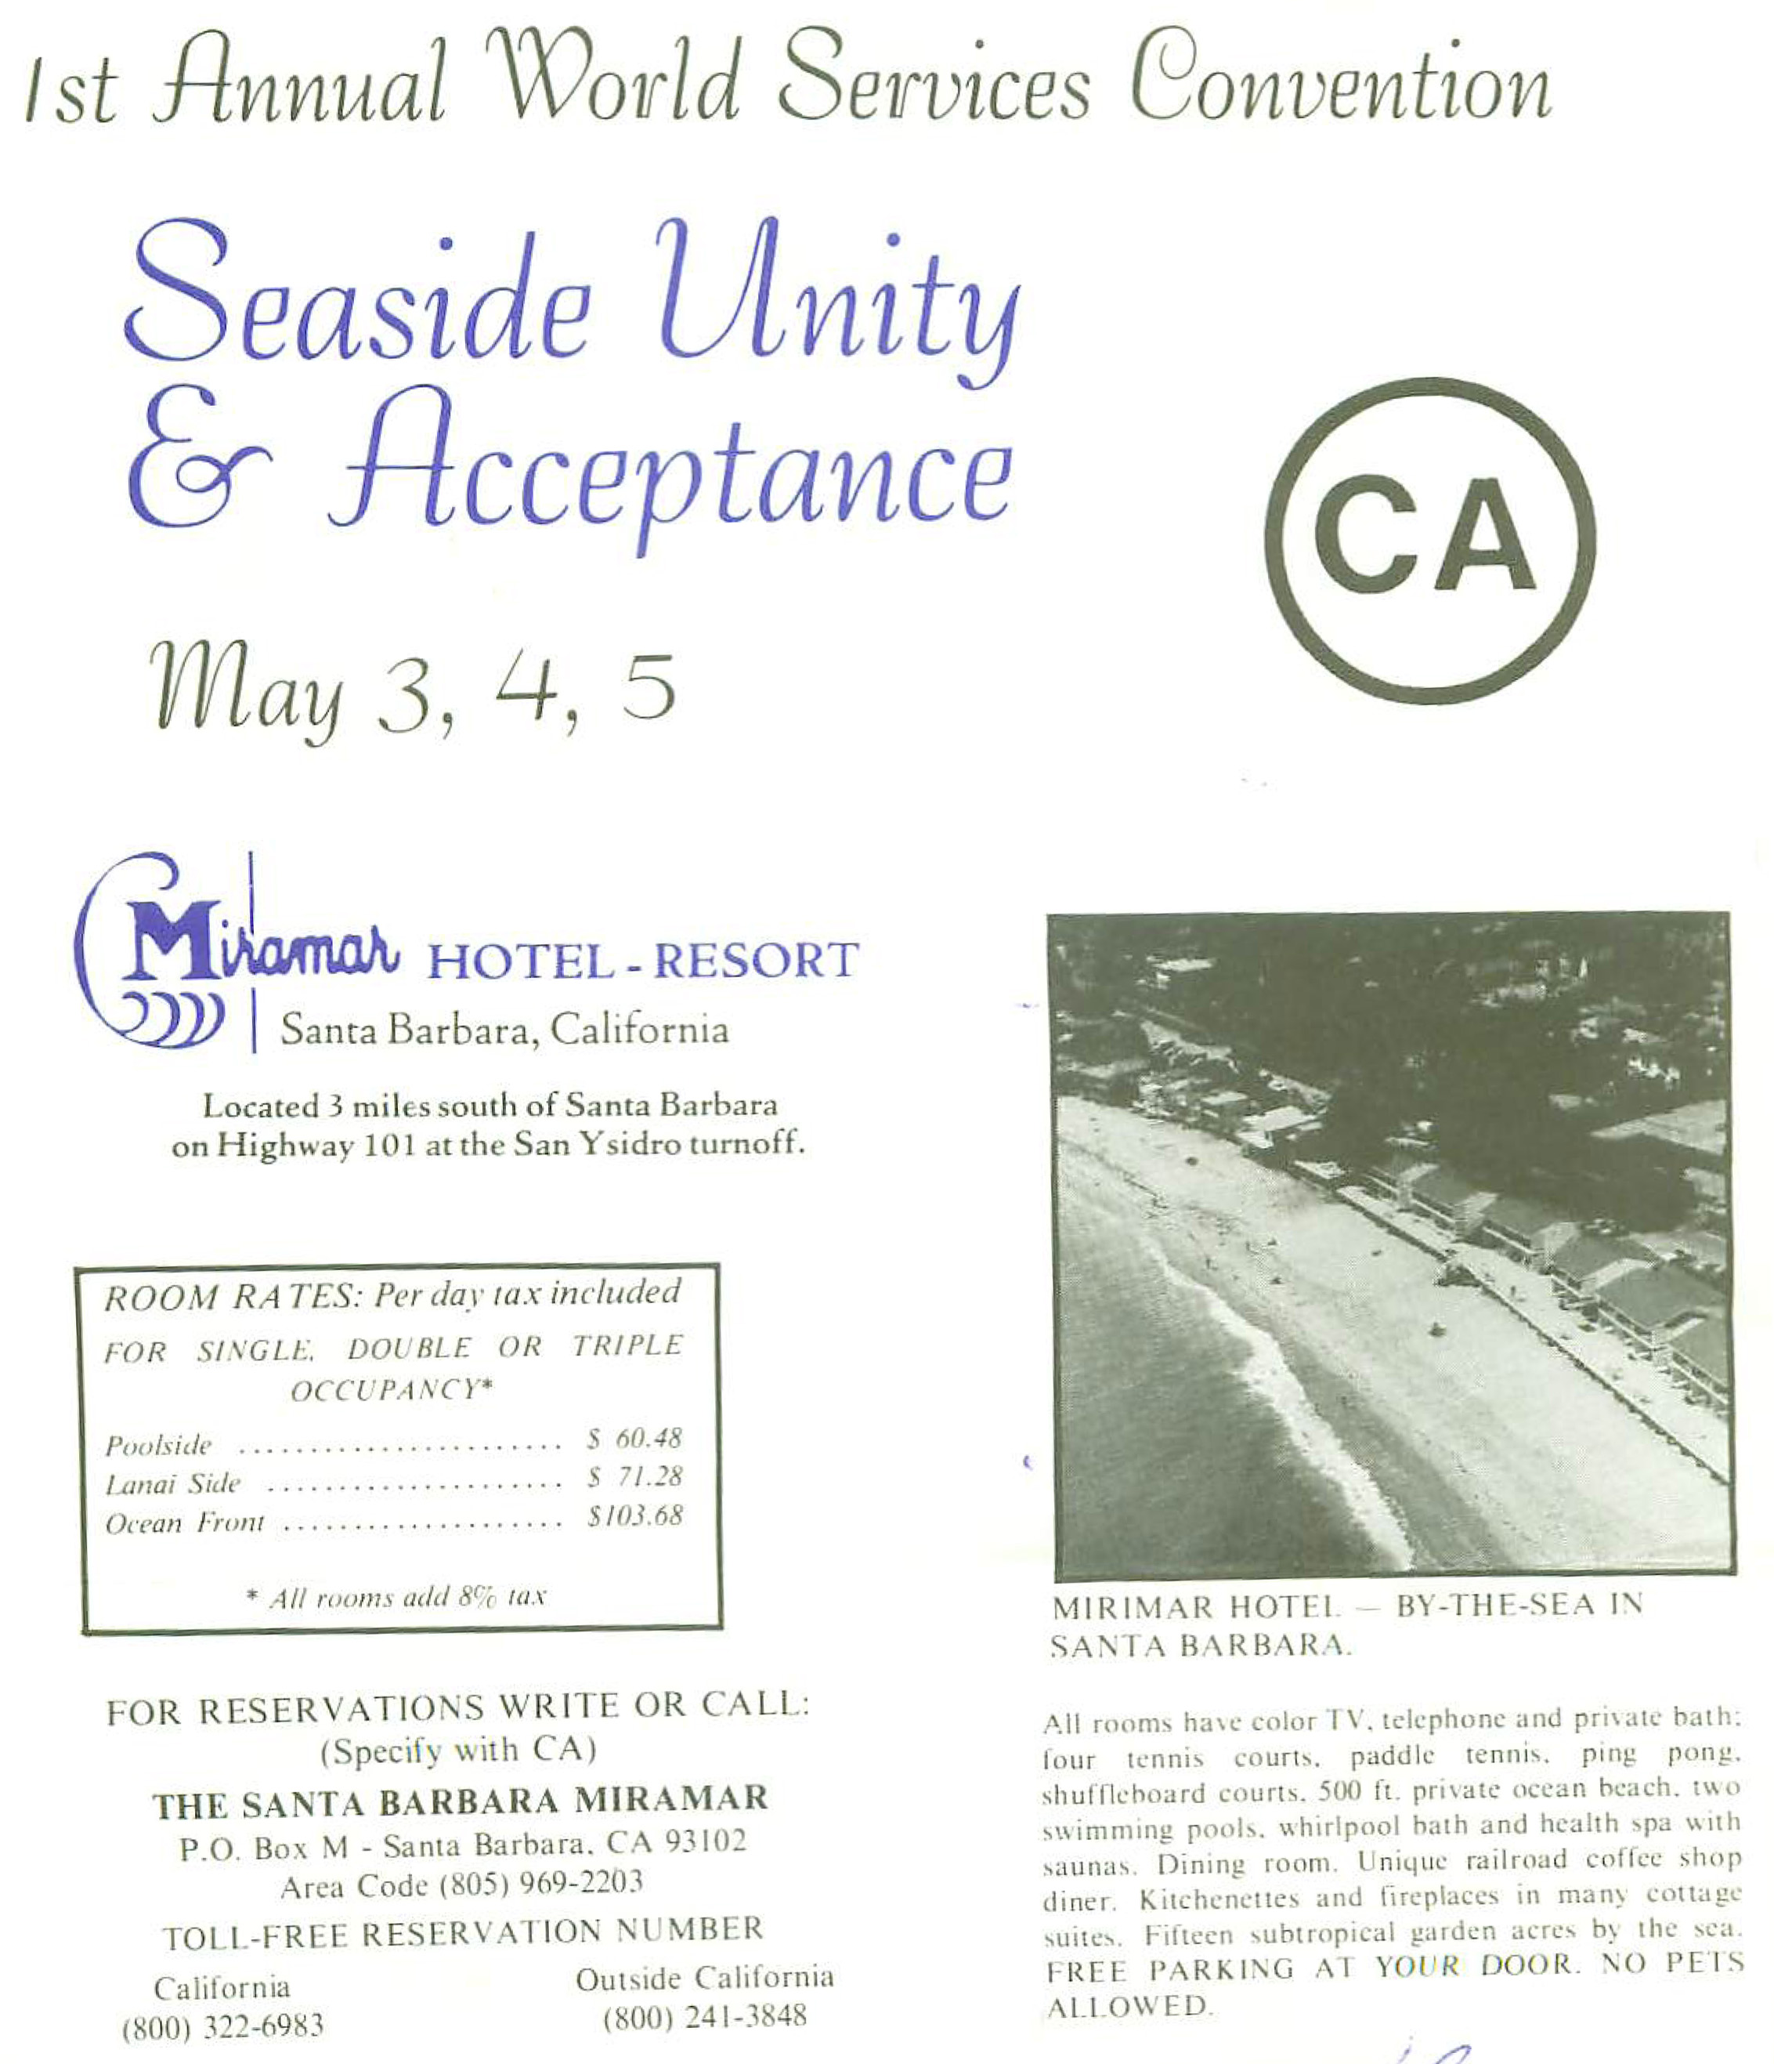
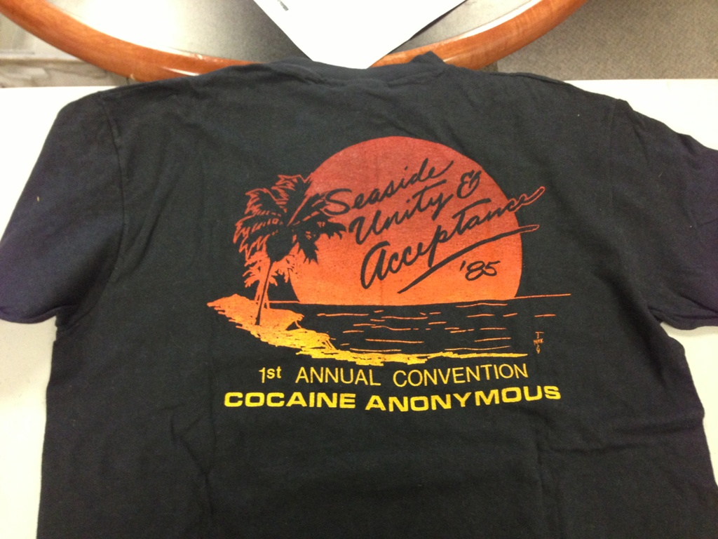
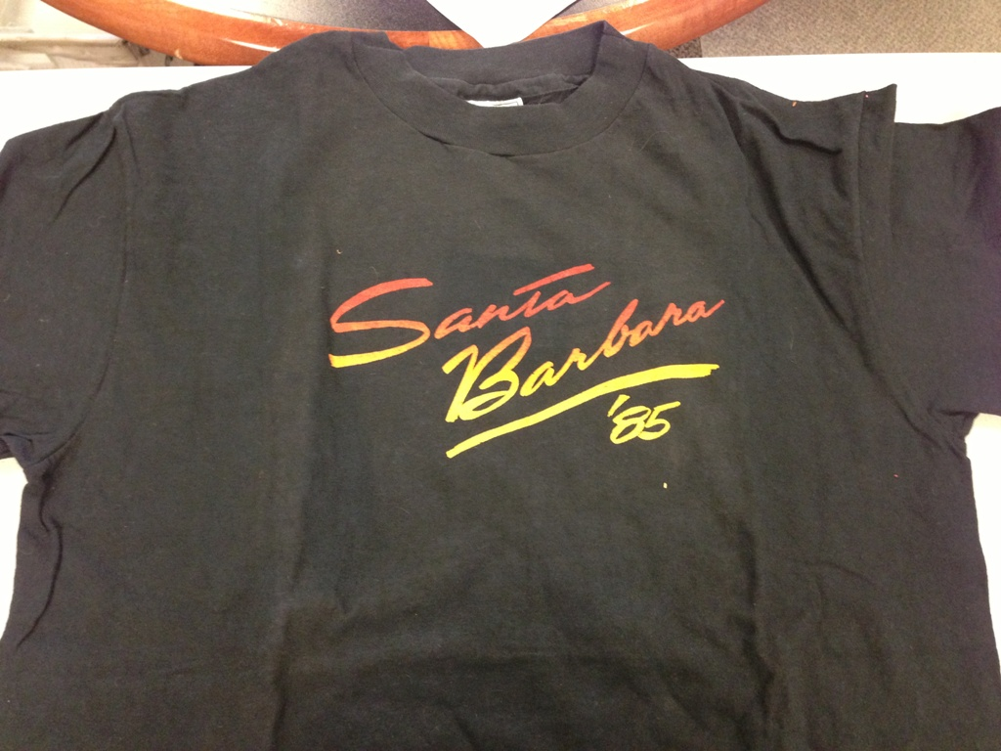
1st C.A. World Convention
Seaside Unity & Acceptance – Santa Barbara, CA - 1985
Convention Highlights: Over 600 people in attendance. People from as far away as the Bahamas and Hawaii to attend.

Slide 33
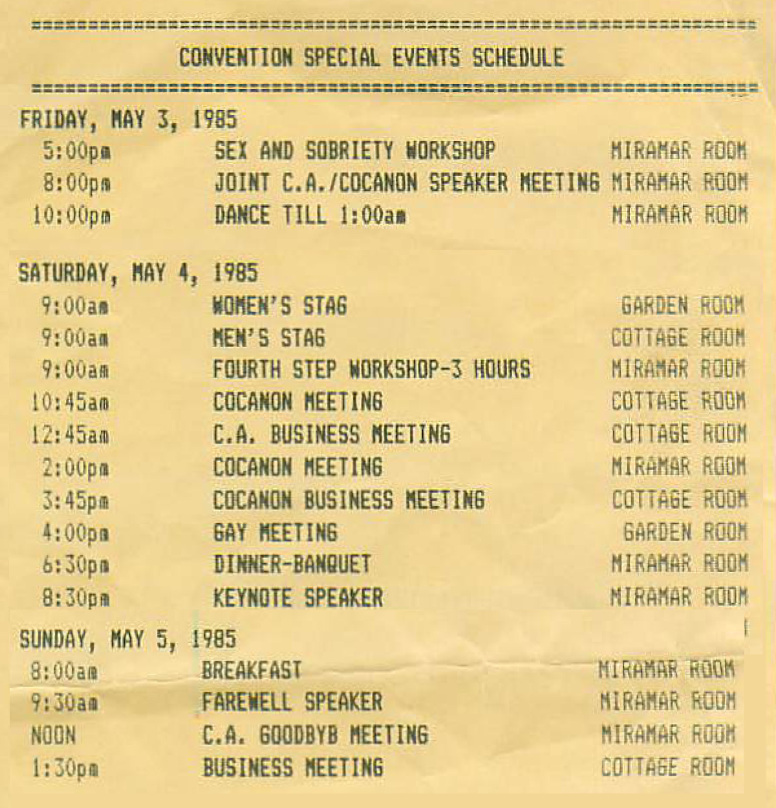
1st C.A. World Convention
Seaside Unity & Acceptance – Santa Barbara, CA - 1985
A number of Areas from across the C.A. Fellowship attended. During the convention, a 3 hour business meeting was held to let the C.A. fellowships know what the fledgling World Service organization was doing. It was decided the next year to have the first World Service Conference.

Slide 34
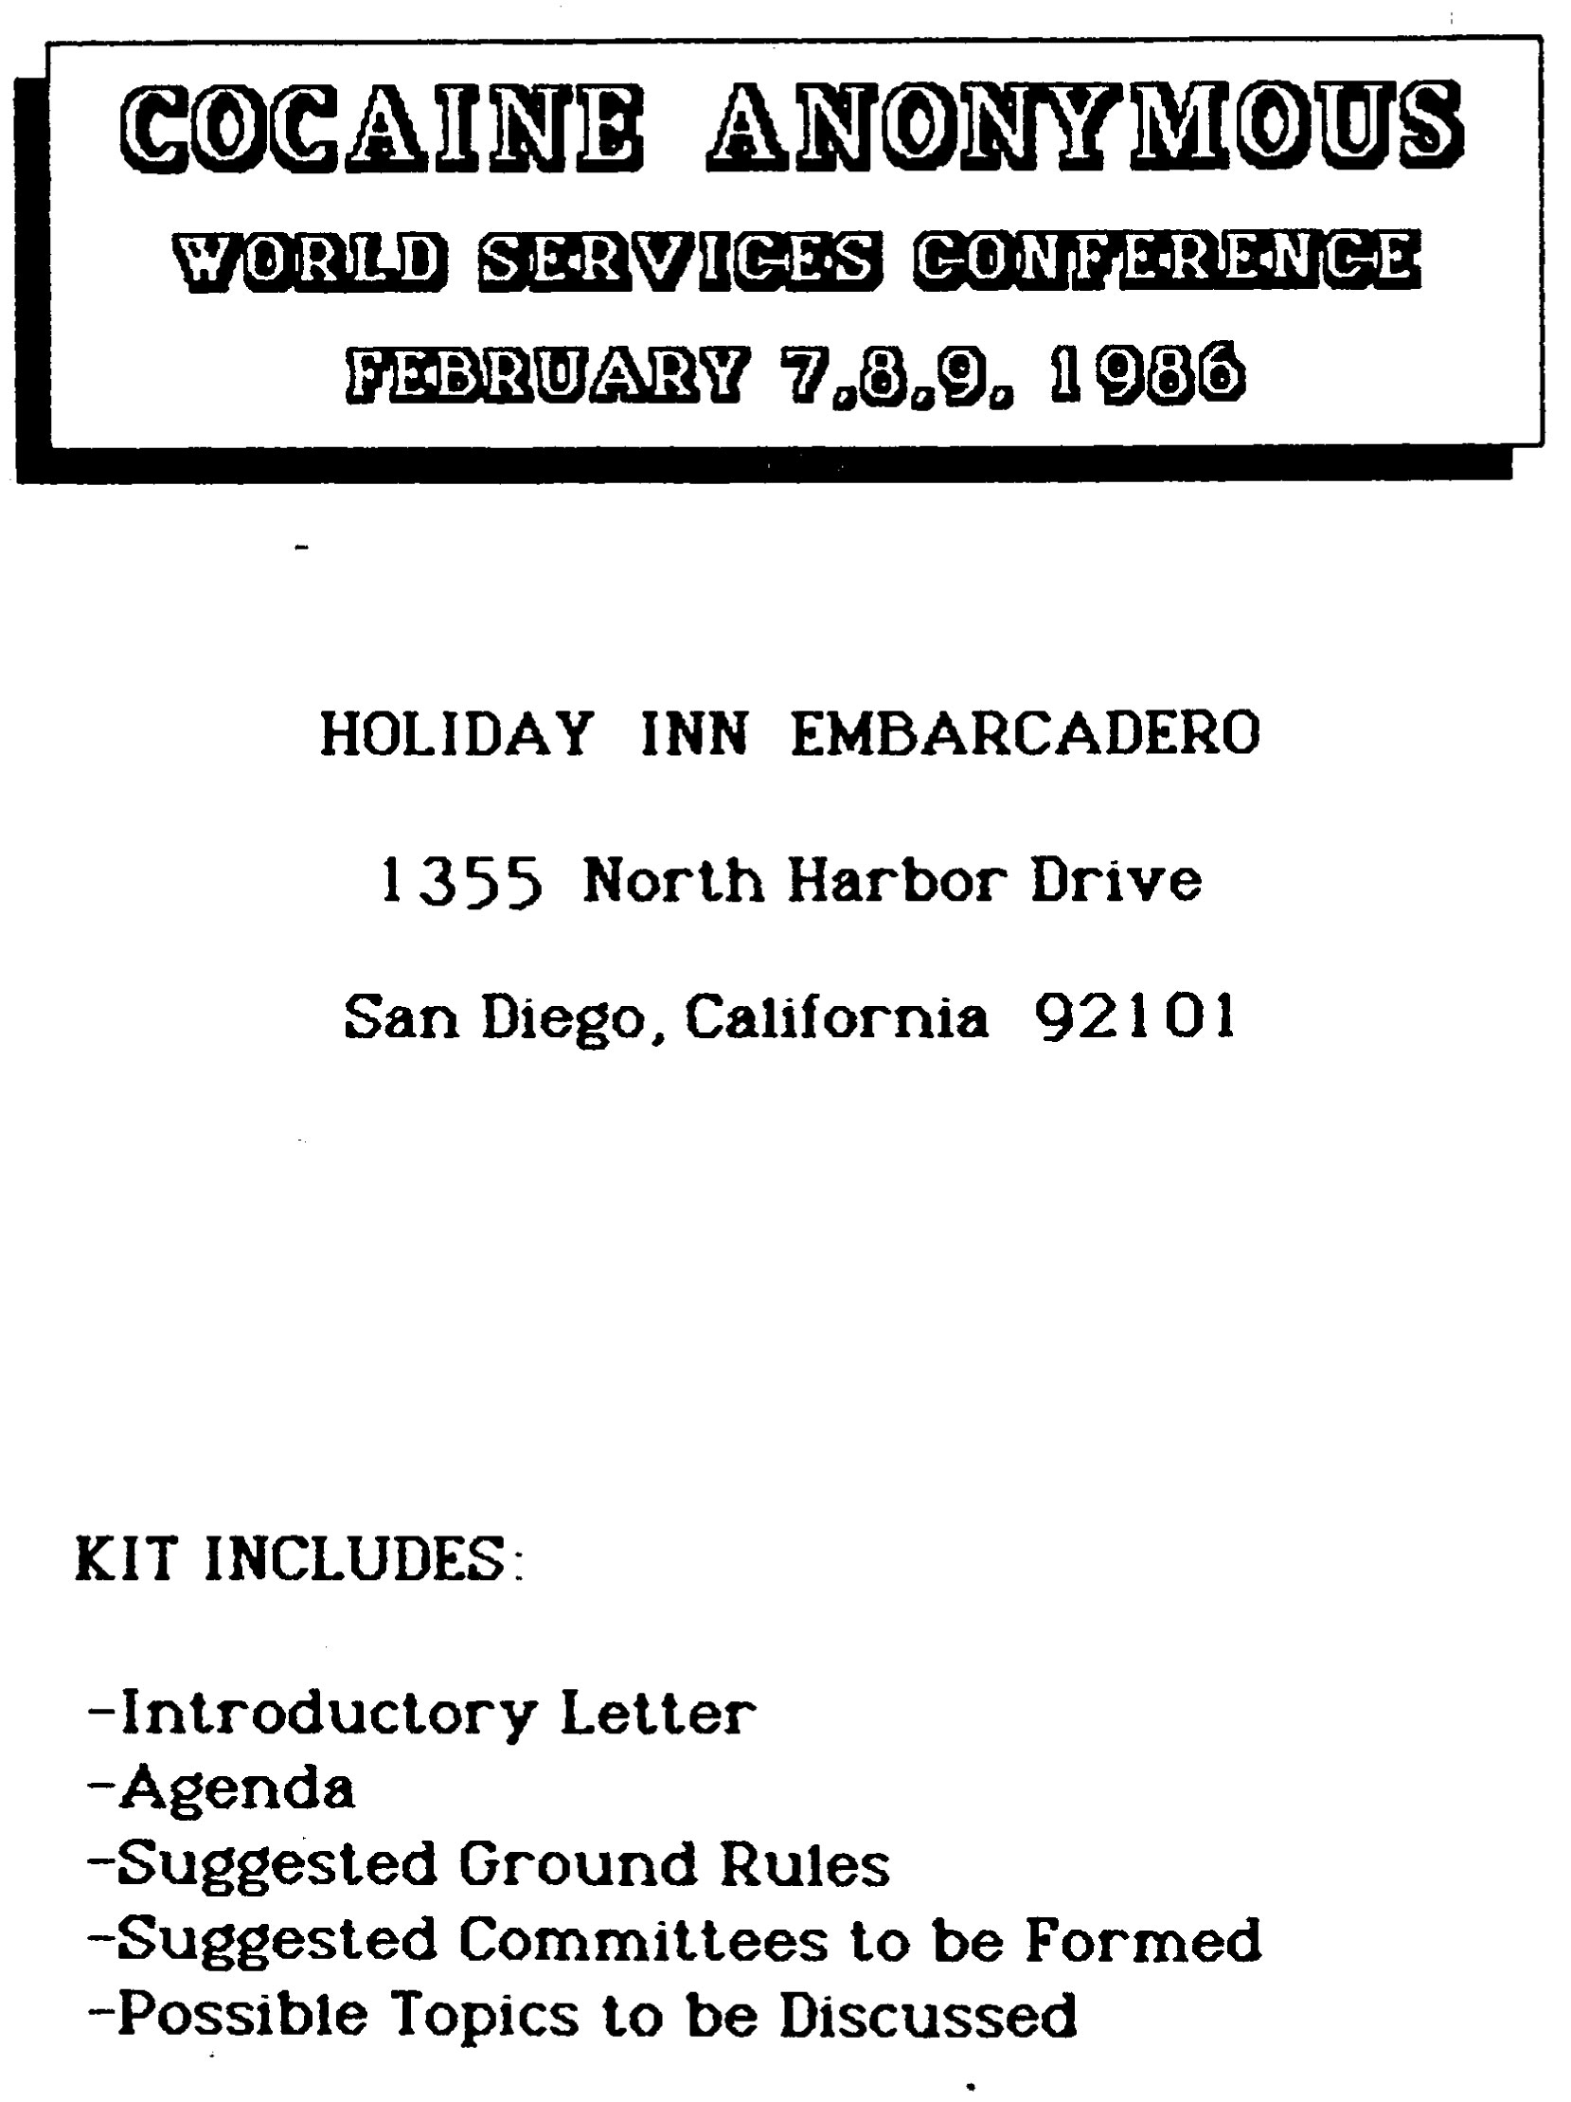
1st C.A. World Service Conference
Scheduled Feb. 7-9, 1986
Gil M., Chairman, Conference Committee Letter to World Services Delegates dated January 2, 1986:
Not a convention, but a business conference to deal with the needs of the Fellowship.
Be prepared to be confronted with a working environment.
Sole purpose—the continuation and growth of C.A.
Delegates to listen to the voices of their Area and bring issues to be heard and voted on.
Establish Standing Committees and develop an agenda for the year; to be carried back to the Fellowship for amendments and approval to be voted on at the next Conference.

Slide 35
1st C.A. World Service Conference Feb. 8-9, 1986
Suggested Ground Rules:
Conference Chair Person serves a two year-term.
Conference Parliamentarian may be a non-addict.
Robert’s Rules of Order are to be followed
Conference open to the Fellowship.
Non-delegates cannot participate on the Conference floor, but welcome on the Committees.
Conference Secretary supplied ahead of time, end of conference a Secretary will be elected for the upcoming year.
Minutes transcribed, published and mailed to Conference delegates within 30 days of the Conference.

Slide 36
1st C.A. World Service Conference Feb. 8-9, 1986
Topics were suggested, put on board and then voted on. The following topics were unanimously passed for this conference:
TOPICS FOR CONFERENCE (Committees):
Literature; Chips; Meeting Format
Internal Affairs; Policy (intergroup); Communications.
Public Information; International; Coconon
Treasury
Structures; by-laws
H & I
Convention
National Directory

Slide 37
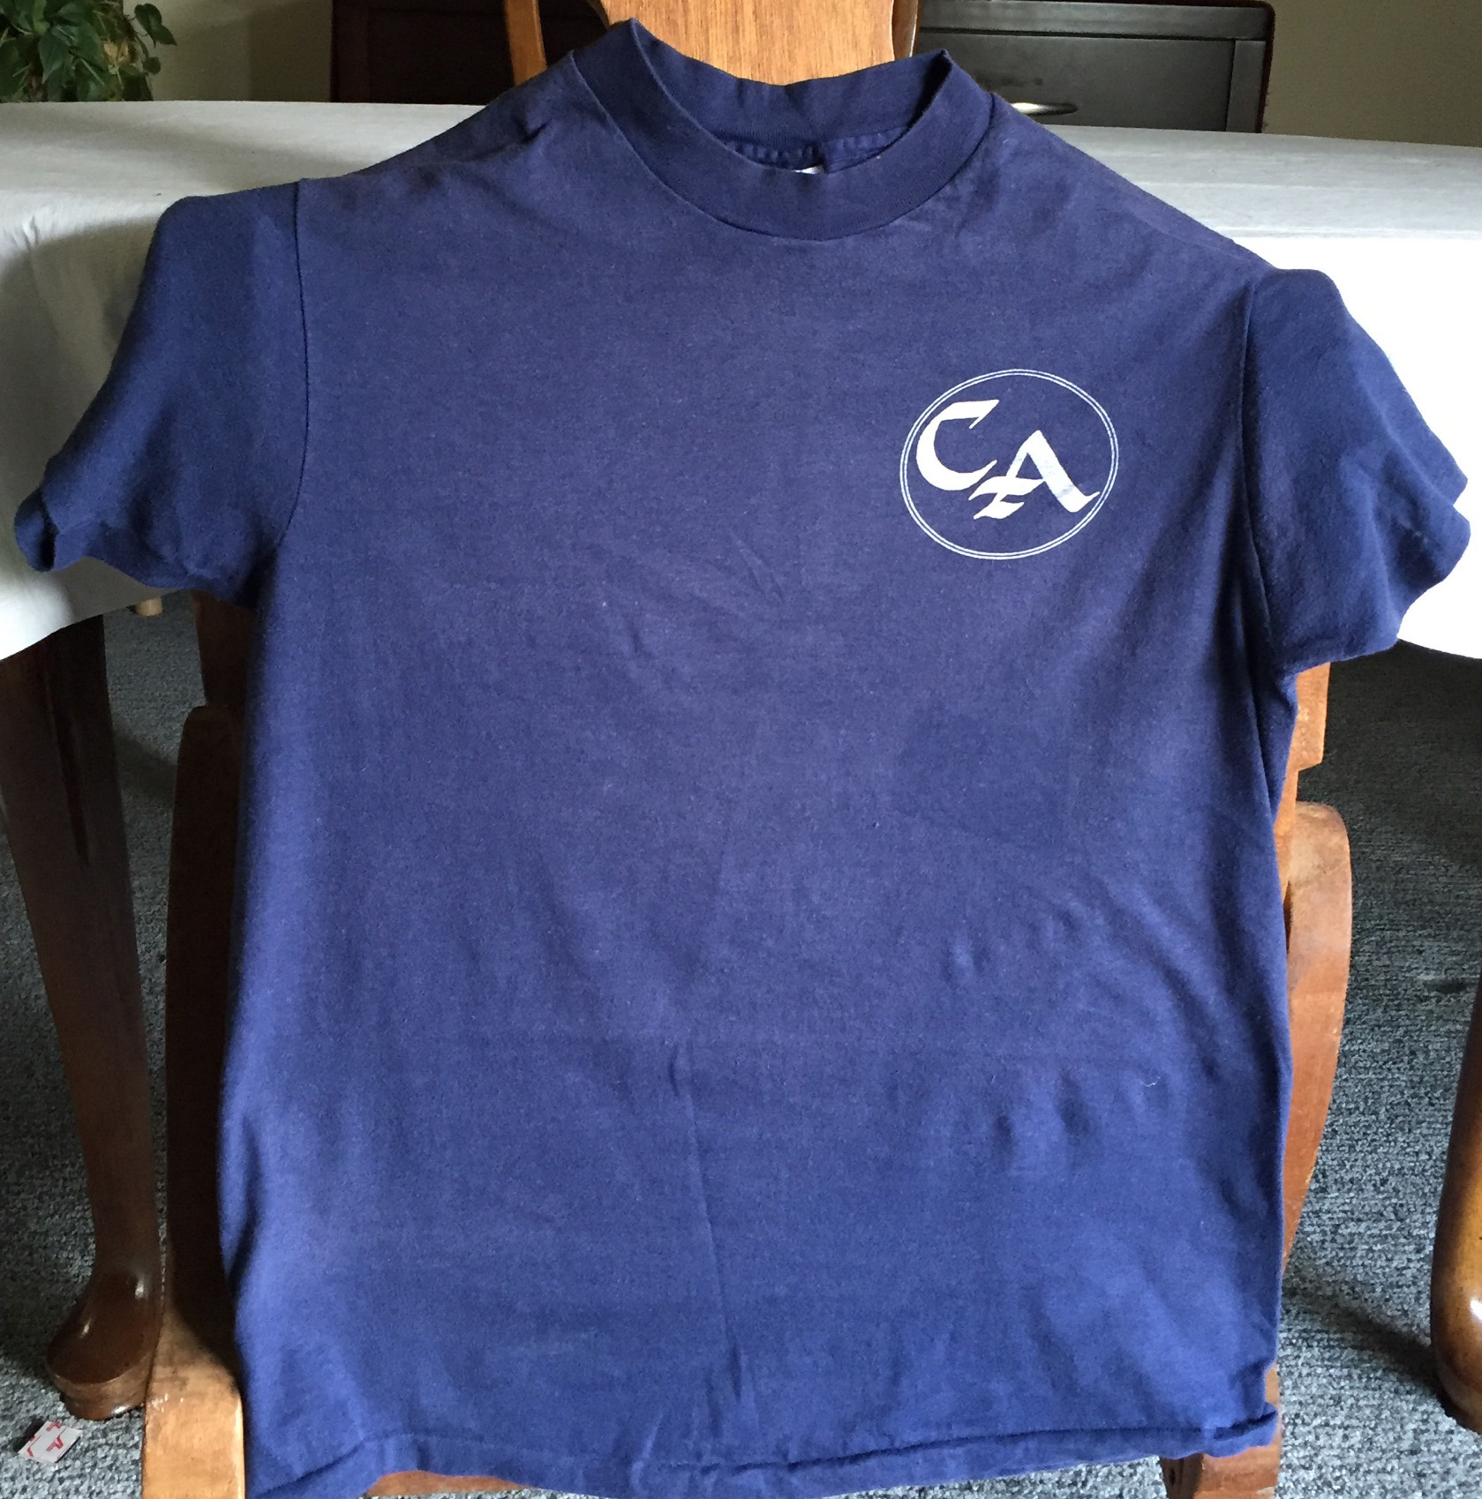
1st C.A. World Service Conference Feb. 8-9, 1986
The original C.A. Areas represented were:
1. Los Angeles
2. San Gabriel Valley
3. San Diego
4. San Fernando Valley
5. Antelope Valley
6. Orange County
7. New Mexico
8. Texas
9. Washington
10. New York
11. Illinois
12. Georgia
13. Michigan
14. Arizona
15. Northern California
16. Inland Empire
Northern California attended, sending six representatives all wearing T-shirts with the logo that they had created. Later in the March 1987 at the 3rd World Service Conference, delegates voted between the CALA logo and the logo that Northern California created (pictured right). The CALA logo won and is the same C.A. logo used today.

Slide 38
2nd C.A. World Service Conference – July 2-3, 1986
The First World Service Office Board of Trustees
H. Lee S., Houston Texas
Bob L., Northern California
Jennifer R., New York, NY
Ray G., Riverside California
Fenn P., Northern California
Reggie L., Southern California
Greg D., Chicago, Illinois
Johnny S., Los Angeles, California
It was felt at the 1986 Conference that a Board of Trustees was needed to represent the Fellowship as a whole. Johnny and Ray (Gil had resigned by this time) interviewed candidates that were presented to them from a slate.

Slide 39
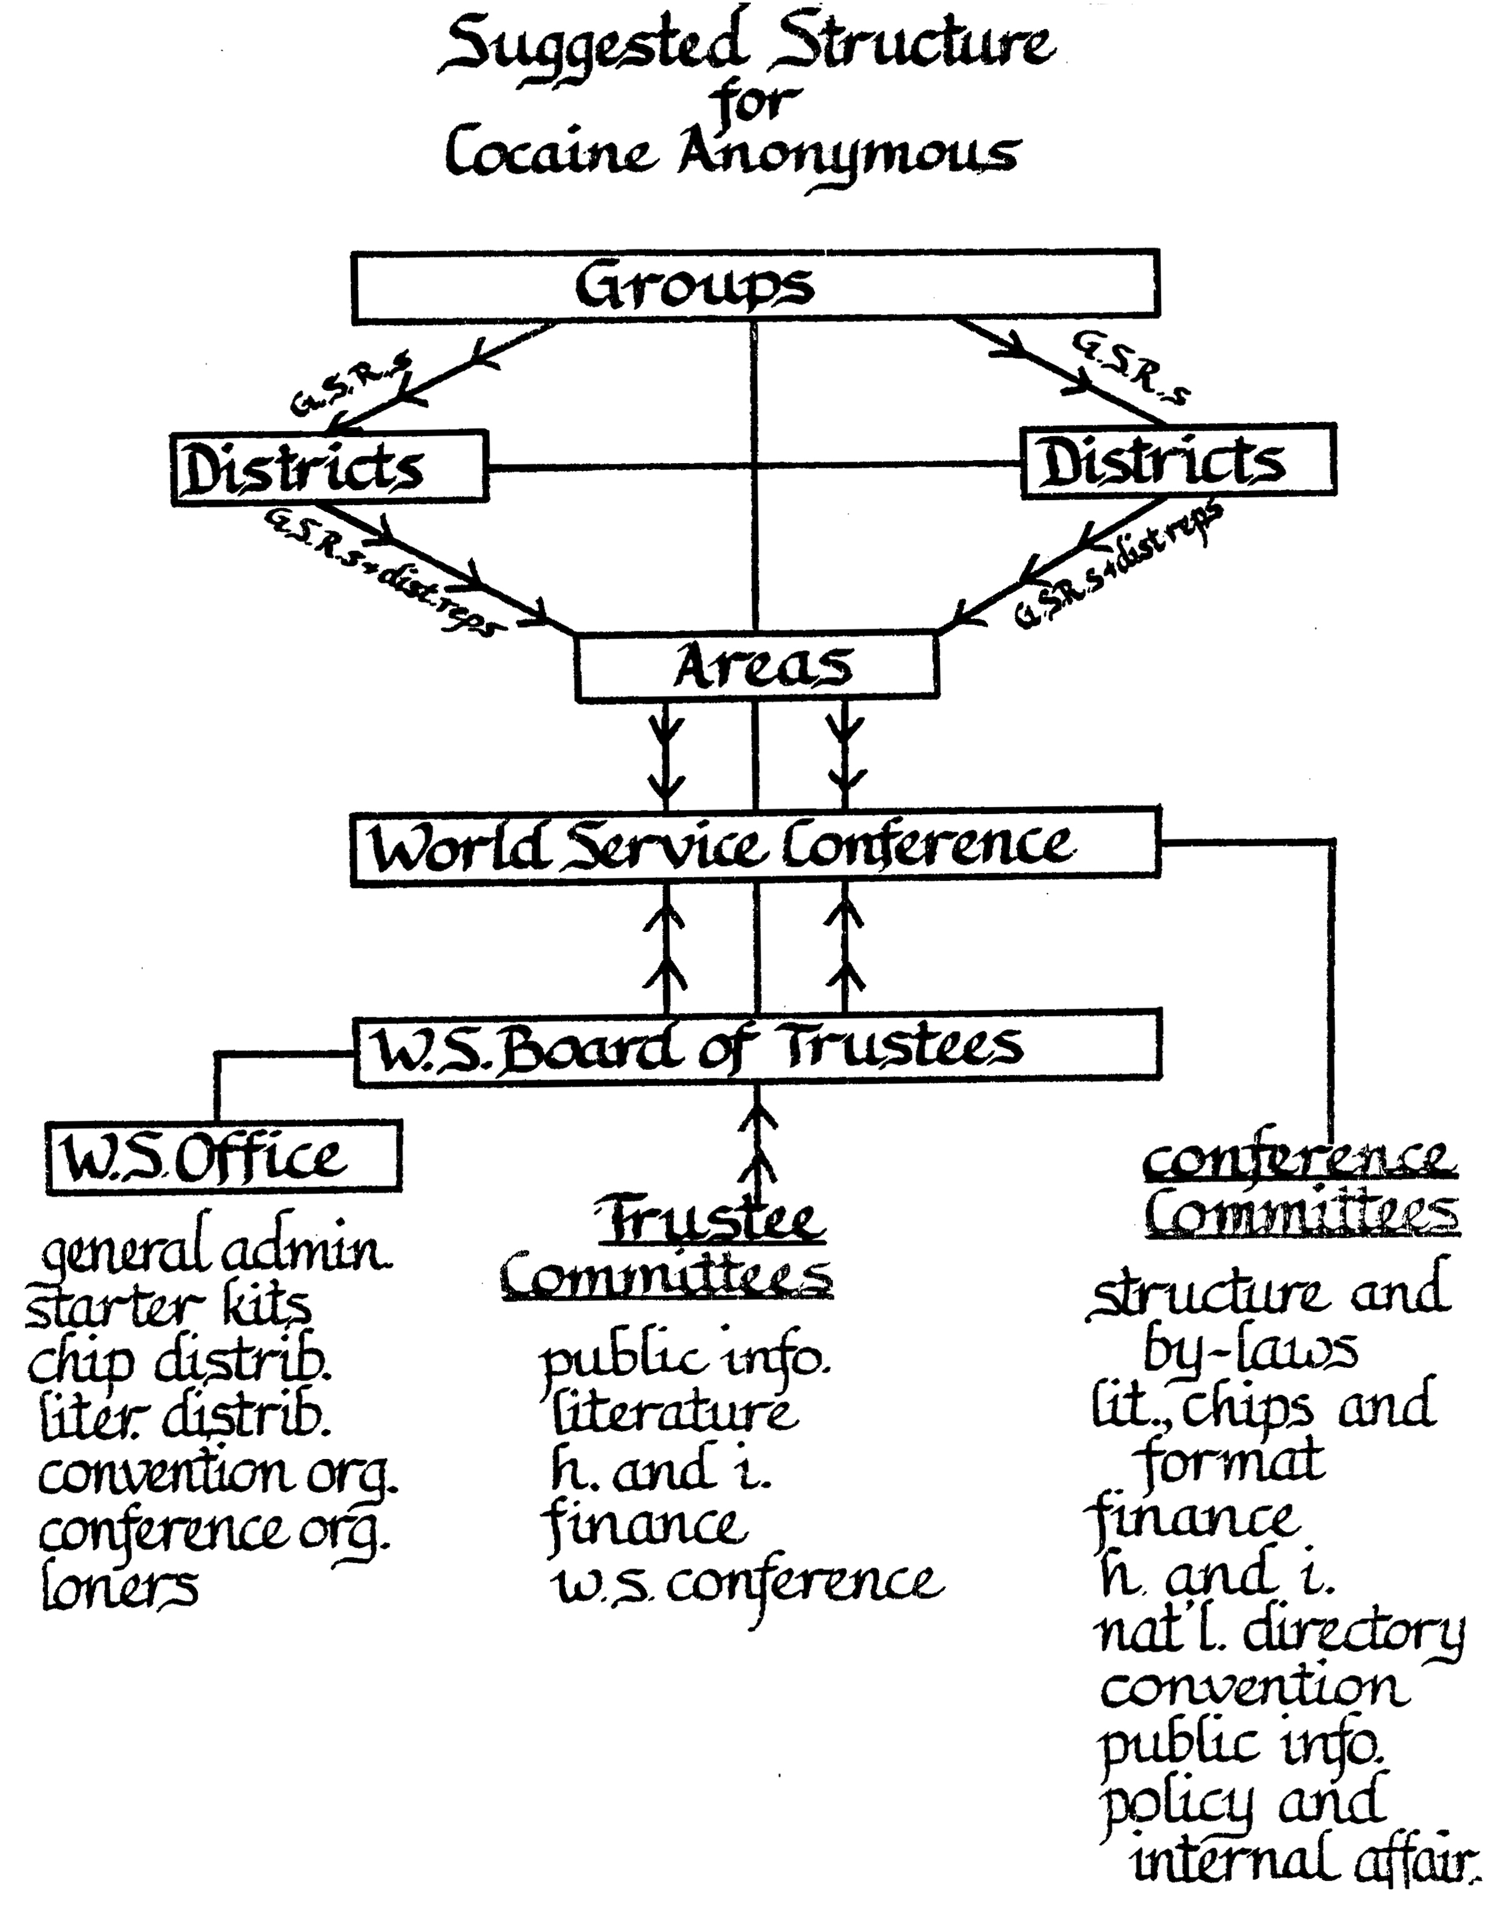
Suggested Structure
for Cocaine Anonymous
Temporary Working Guide to the Service Structure
Ratified at the
2nd World Service Conference in San Diego, CA, July 1986

Slide 40

Other C.A. WSC Firsts
At the 1st World Conference (Feb. 9, 1986) it was ratified: “WSO approved literature – whenever Cocaine is mentioned it should read “Cocaine and all other mind altering chemicals.” Cited in the 2nd World Conference (July 2, 1986) minutes, under “Qualifications for a Trustee,” point 5, it reads, “A minimum of 2 years of continuous abstinence from cocaine and all other mind altering substances.” The First Step of C.A. was changed to say, “Cocaine and all other Mind Altering Substances when the 12 Steps and 12 Traditions were ratified at the 3rd WSC, on March 22, 1987.
Johnny S. - history of C.A.’s Step One
March 1987 — 3rd World Conference: Woodland Hills, California. At this conference, it came up that there seemed to be an imbalance of our voting procedures. Lionel’s motion that ONLY THOSE PEOPLE WHO ARE ALLOWED TO VOTE ARE THE ONES PERMITTED TO DISCUSS PROPOSALS AT THE MICROPHONE; THAT INCLUDES DELEGATES, TRUSTEES, AND ONE VOTE FROM THE WORLD SERVICE OFFICE was passed (45 to 15). They were not happy. And original Office Board left the conference in protest. One member stayed, and became the Conference Chair. His name was Lionel. Shortly after the conference, the WSBT had to appoint an Office Board to replace the walk out members. (March 1987 Conference Minutes - Summary of Motions).
November 1987 — 4th World Conference: Bylaws and Charter were approved and 70/30 Plan was created and passed.
August 1988 — 5th World Conference: Descriptions of Areas, Districts and Regions were created, along with who can use the C.A. name.
August 1989 — 6th World Service Conference: The A.A. Big Book and A.A. 12 Steps and 12 Traditions were accepted as our tools of recovery. Passing this motion made by the LCF Committee (Alan S. was the Chair) allowed the Big Book and the 12 X 12 to appear on the tables of C.A.

Slide 41
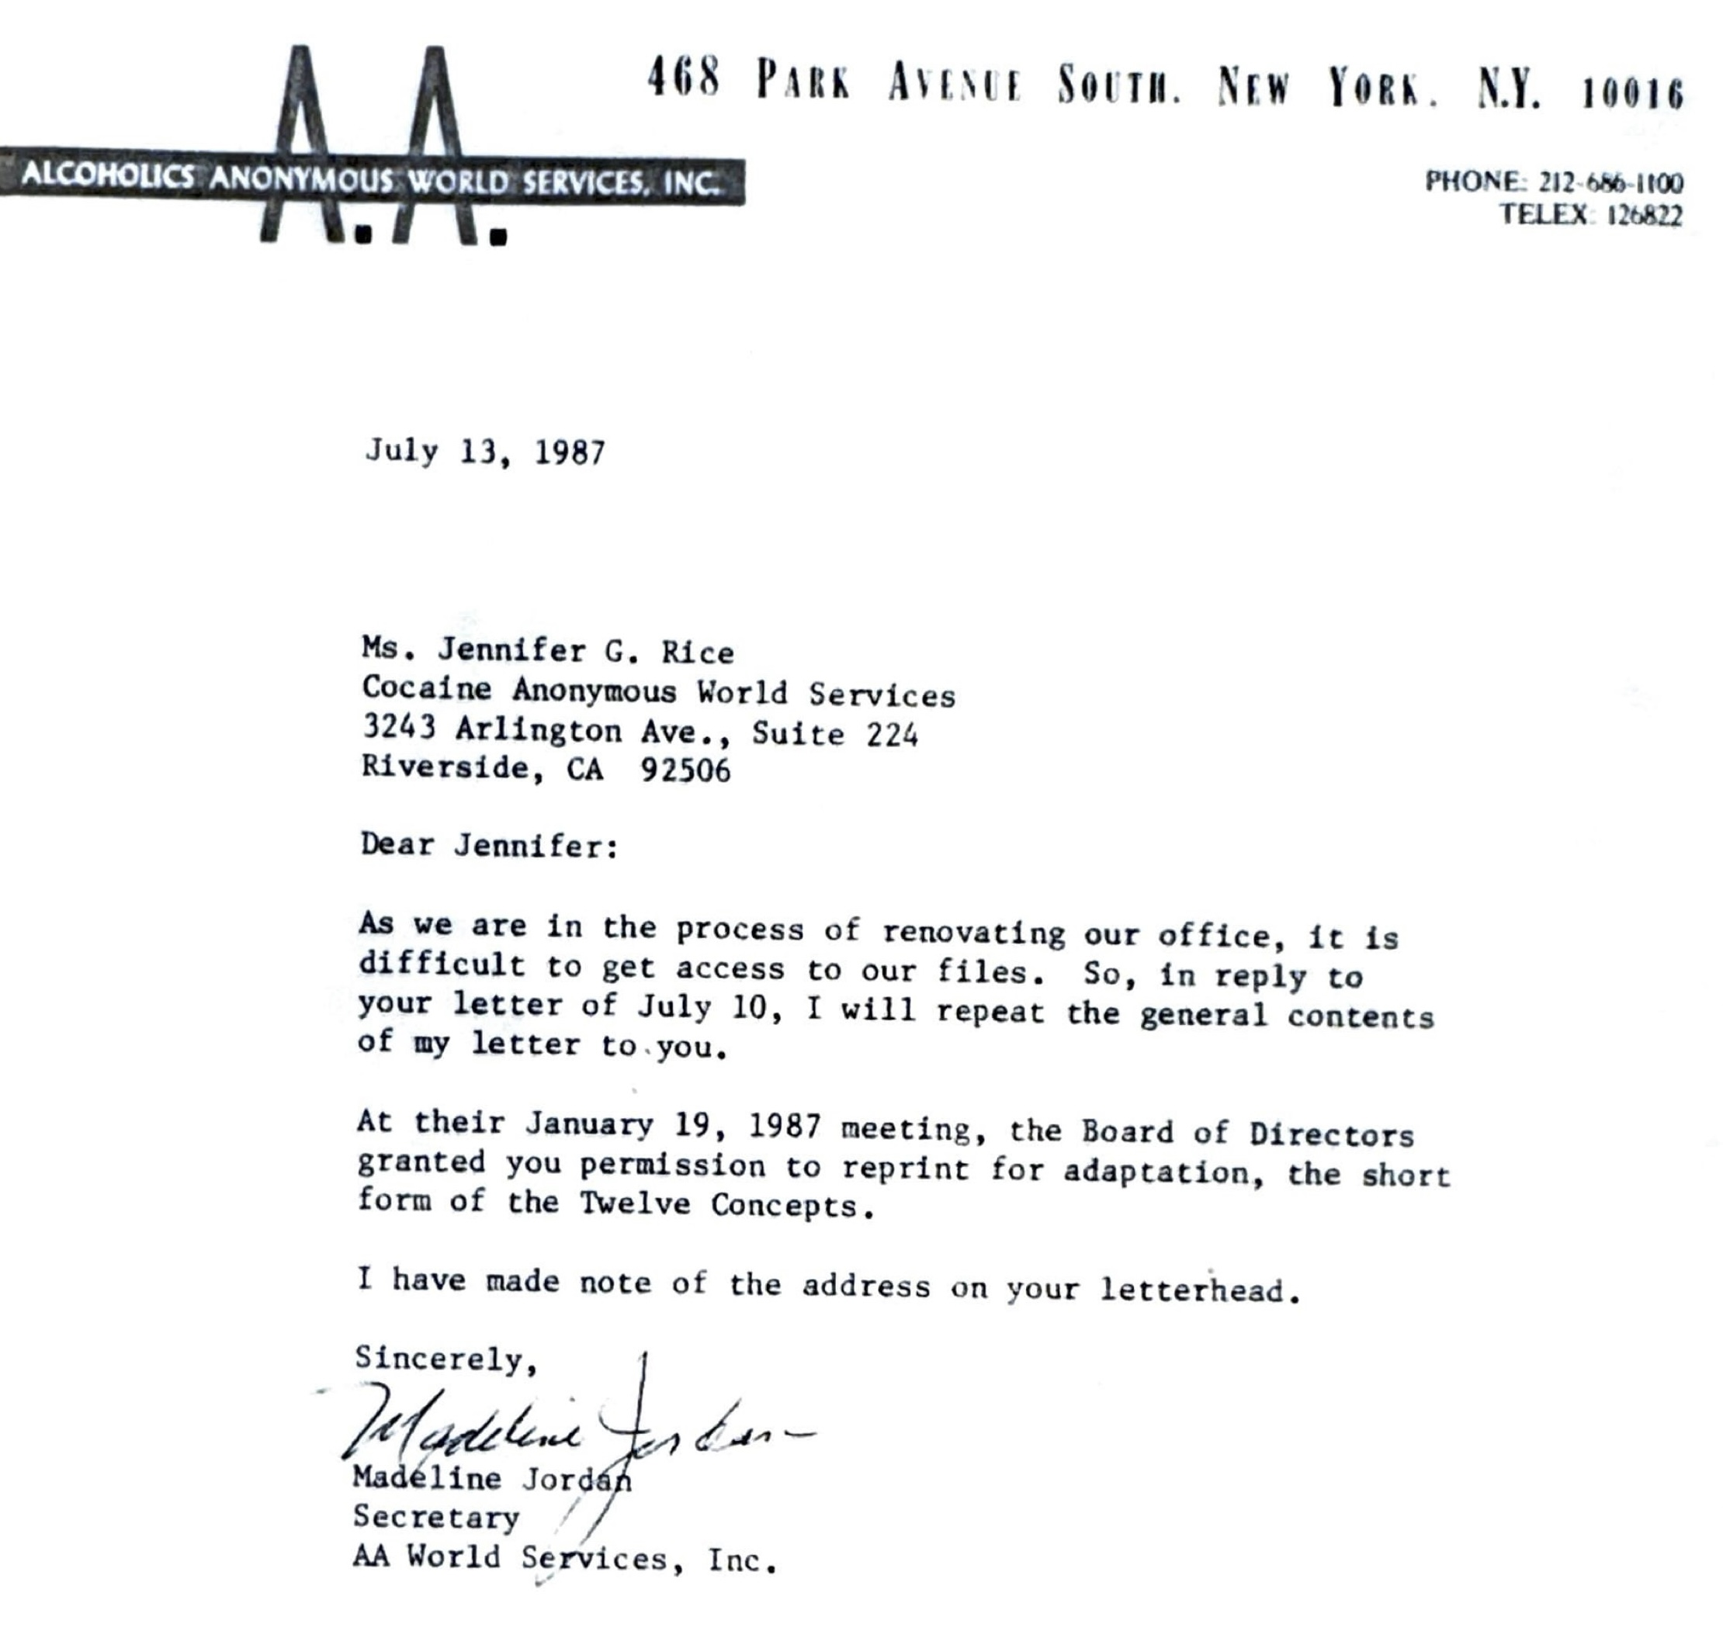
Early A.A. Correspondence with C.A.
Thanks to Jennifer R. (one our first Trustees elected in July 1986) contacted A.A. World Services in New York and received this reply:
On Sun, Jan 29, 2023 at 11:34 AM Mirza, Michelle wrote:
I (Michelle V Mirza, A.A. Archivist) did find reference to adapt A.A.’s Twelve Steps and Twelve Traditions in the AAWS Board reprint report of August 16, 1984, to read as follows: “A motion was made and passed, that permission be granted to Cocaine Anonymous, Van Nuys, CA, to reprint for adaptation, the Twelve Steps and Twelve Traditions.”
Sincere regards,
Michelle V Mirza, Archivist
General Service Office of Alcoholics Anonymous
475 Riverside Drive, 11th Floor
New York, NY 10115
(212) 870-3059
http://www.aa.org

Slide 42
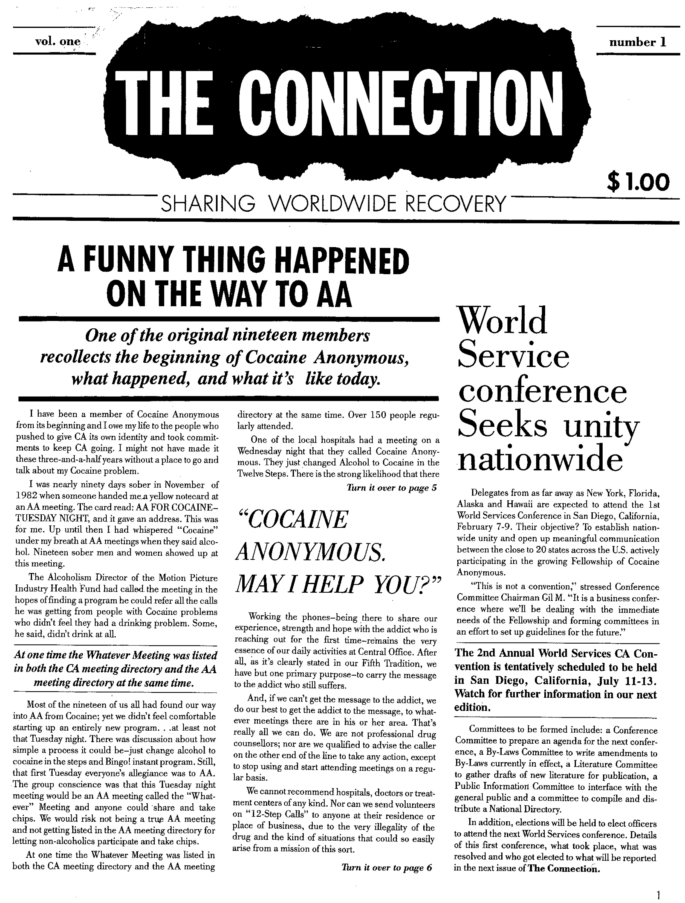
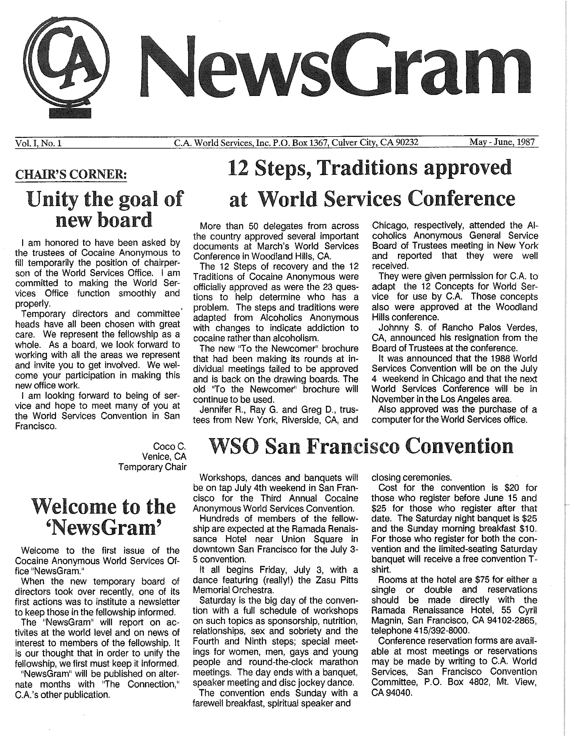
C.A. Newsletters https://museum.ca.org/ca-newsgram/
Vol. 1, No.1—1986
Vol. 1, No. 1 — 1987
The Connection and the NewsGram were simultaneous publications. The Connection was primarily recovery stories, whereas The NewsGram was about what was going on in the Fellowship, Conference Reports, Committee Reports, etc.

Slide 43
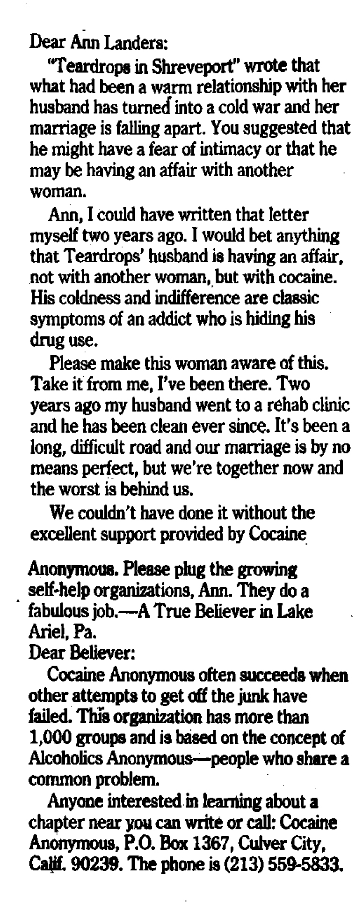
Ann Landers applauds C.A.
Chicago Tribune, September 13, 1988
A letter and reply by Ann Landers in which the author of the letter Cocaine Anonymous as essential to her husband’s continuing recovery.
Signed it “A True Believer”
Ann Landers replied by printing the address and phone number of the WSO.
Response was phenomenal: over a 3-day period, Helene H. WSO Chairperson reports receiving over 600 letters of inquiry!

Slide 44
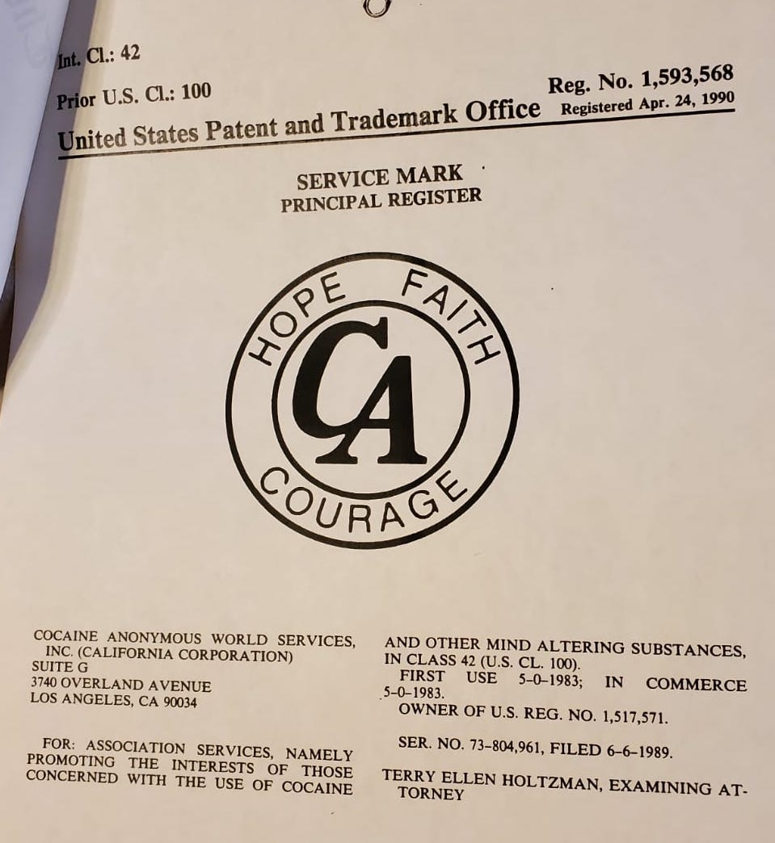
“ENFORCE IT OR LOSE IT”
C.A. Battles to Protect Copyright Privileges
July/August 1989 – Trustee Jack P. spearheads “Enforce It or Lose It” campaign whereby C.A. battles to protect copyright privileges. In 1989, a Dr. Baron advertised a C.A. recovery program in Houston, Texas by the name of “C.A. Aftercare.” C.A. had to defend itself by sending communication to Dr. Baron that this was not an organization that had anything to do with C.A. It came to the point where this issue may have had to go to court. But after much communication between our C.A. lawyer and Dr. Baron he finally changed the name of his program.
(CAWS NewsGram, Vol II., No. 4, pg1., July-August 1989)

Slide 45
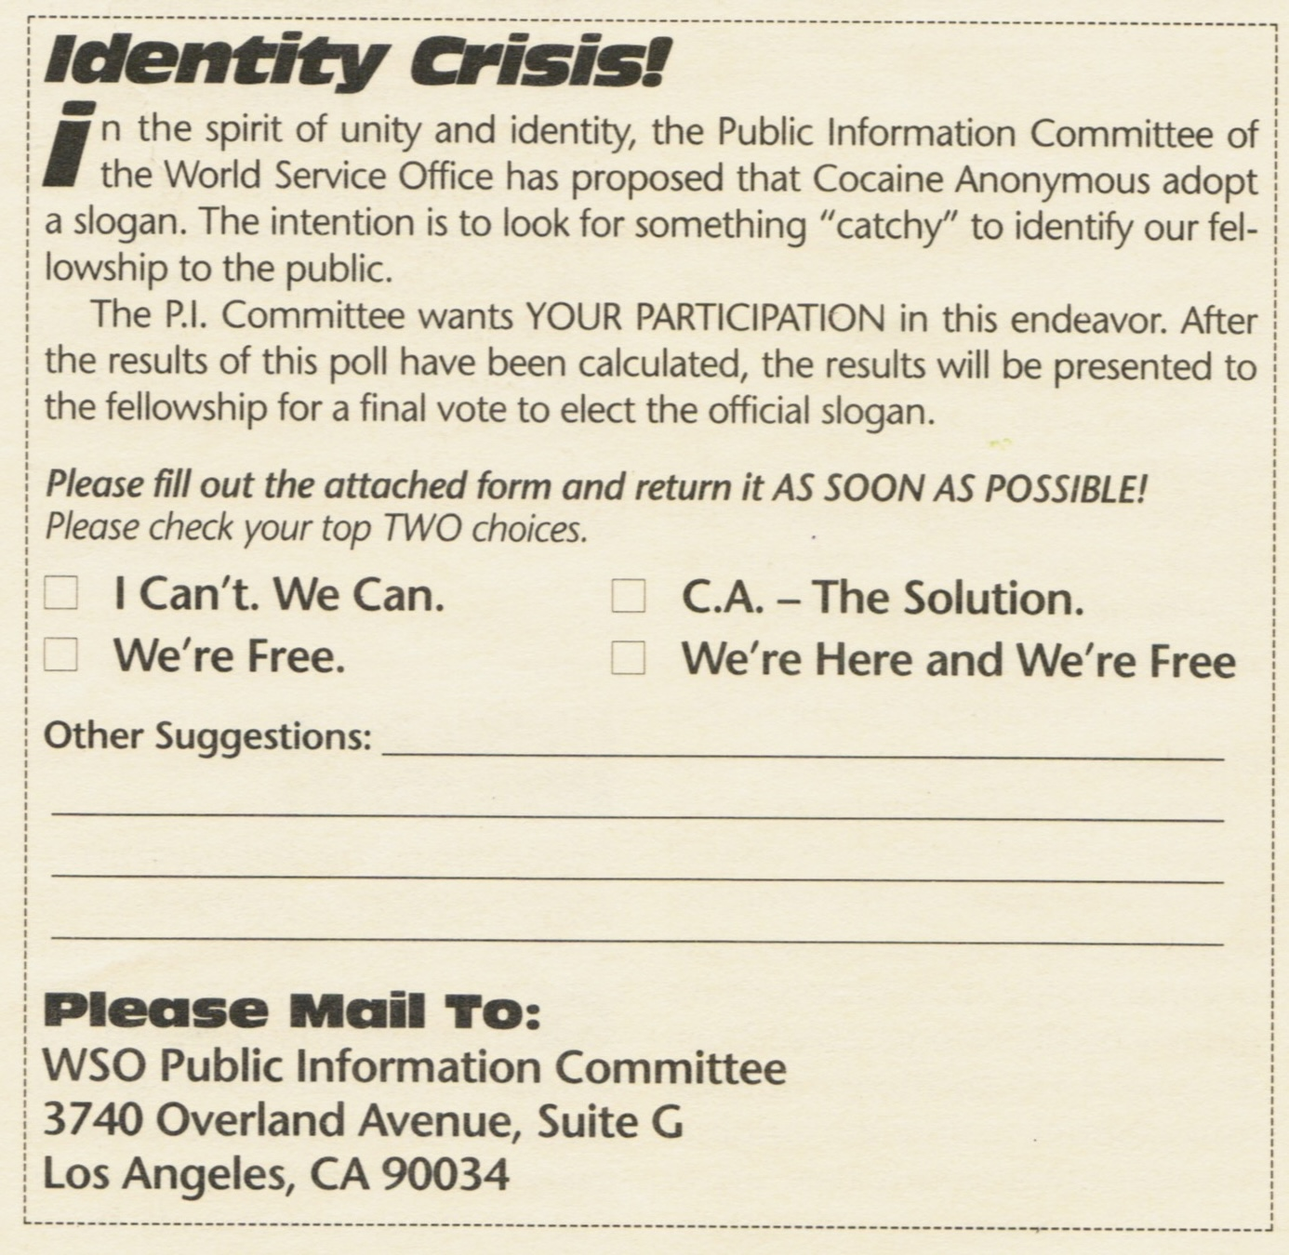
Our C.A. Slogan
“We’re Here and We’re Free.”
August 30, 1991 – PI Committee Motion to “APPROVE ONE OF THE FOLLOWING SLOGANS TO BE USED BY COCAINE ANONYMOUS, ‘WE’RE HERE AND WE’RE FREE’, OR ‘CA: THE SPIRIT OF RECOVERY’ OR ‘ESCAPE COCAINE’, OR THERE’S NO GRAM LIKE THE PROGRAM,” which passed 59-35. In a selection vote for slogan, “We’re here and we’re free.” and “CA: The Spirit Of Recovery” received the most votes. “We’re here and we’re free” was selected in a runoff vote 52-28.
(Source: Minutes, 8th World Conference, August 30, 1991)

Slide 46
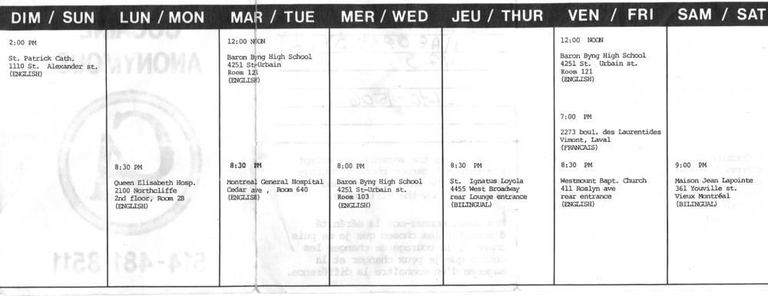
First C.A. Meeting Outside the United States
Montreal, Quebec, Canada, August 21, 1986, Robert F. meets with his friend, Dave S. who is dating a woman from California who introduces him to some C.A. meetings. Dave's enthusiasm for C.A. — a fellowship where one could talk freely about drugs—inspired Robert F. and together they ordered a C.A. starter kit and on a Thursday night, August 21, 1986, the first Canadian C.A. meeting was held in Montreal, Quebec—the first C.A. meeting outside the United States. There were about 20 people who attended. Dave S. was the speaker and Robert F. was the secretary.
Late 1986 Montreal Meeting List

Slide 47
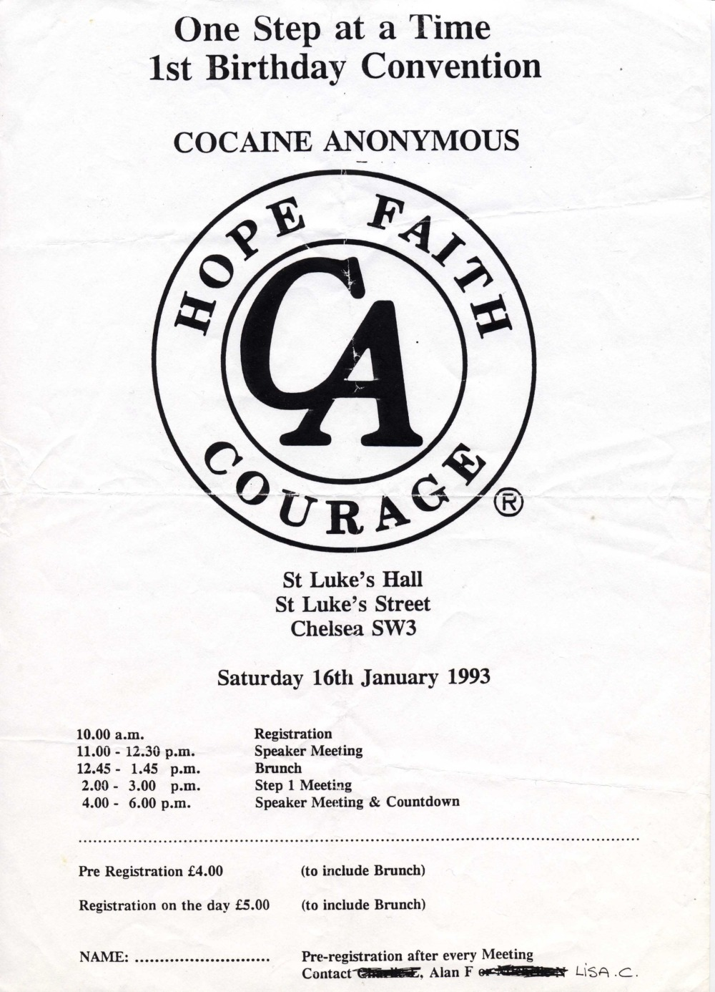
First Overseas C.A. Meeting in London, UK
January 8, 1992 by Lisa C.
Listen to Lisa C. Share how C.A. got started in the UK.

Slide 48
Growth of the UK & European C.A. Areas
European Region Ratified - Aug. 30, 2005
Mainland Europe Region Ratified - Aug. 28, 2019
CAUK Area - Aug. 28, 1996
Hong Kong Area - Sept. 1, 2004
Scotland Area - Sept. 1, 2004
Holland Area, Sept. 1, 2004
South Africa - Aug. 30, 2005
Spain Area - Aug. 29, 2006
Germany (Deutschland) Area - Aug. 28, 2007
Ireland Area - Aug. 31, 2010
Switzerland Area - Aug. 28, 2013
Russia Area - Aug. 28, 2013
Peru Area - Aug. 28, 2013
Denmark Area - Sept. 2, 2015
Central UK Area - Aug. 31, 2016
London Area - Aug. 31, 2016
Portugal Area - Aug. 28, 2019
Thailand Area - Aug. 28, 2019
China Area - Sept. 1, 2021
Indonesia Area - Sept 1, 2021
Wales Area - Sept. 1, 2021
West County Area - Sept. 1, 2021
Greece Area - Aug. 31, 2022
Sussex Area - Aug. 31, 2022
Holland Noord Area - Aug. 31, 2023
France Area - Aug. 28, 2024
Poland Area - Aug. 29, 2024
Belgium Area - Aug. 28, 2025
Australia Area - Aug 28, 2025
Online Recovery Area - Sept. 2, 2026
Online GB Area - Sept. 2, 2026
Norway Area - Sept. 2, 2026

Slide 49
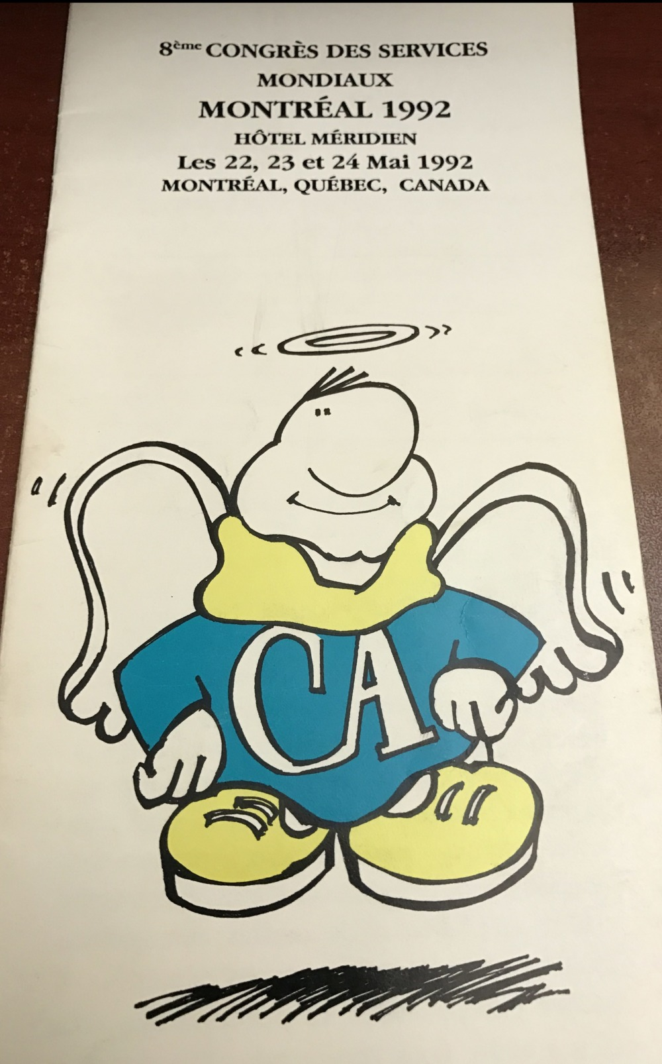

C.A. World Convention Firsts
8th World Service Convention
Montreal, PQ – 1992.
First Convention outside the USA.
28th World Service Convention
May 24-28, 2012 Birmingham, UK
First Convention outside North America

Slide 50

C.A. World Convention Firsts
First Non-English Speaking, Mainland Europe
35th World Convention 2019
Stockholm, Sweden
Today Sweden has more than 72 C.A. meetings.

Slide 51

2nd Non-English Speaking, Mainland Europe
2024
38th World Convention
Noordwijkerhout Nederland
Meetings in Holland today number:
157 in-person
27 online
10 H&I

Slide 52

41st World Convention - May 27-31, 2027
https:/caws2027.org

Slide 53



C.A. Publications
Alan S., LCF Chair, brought an idea to the 1989 Conference that C.A. should have its own book comprised of stories from our members. Stories from around the C.A. fellowship were collected, selected, edited and approved. Bill Z. (San Diego, CA), as the chair of the LCF CA Book sub-committee contributed greatly to getting HFC to publication in 1993. It was a HUGE success for C.A. garnering a “pre-sale” of hundreds of cases of books.
1993
2007
2014

Slide 54
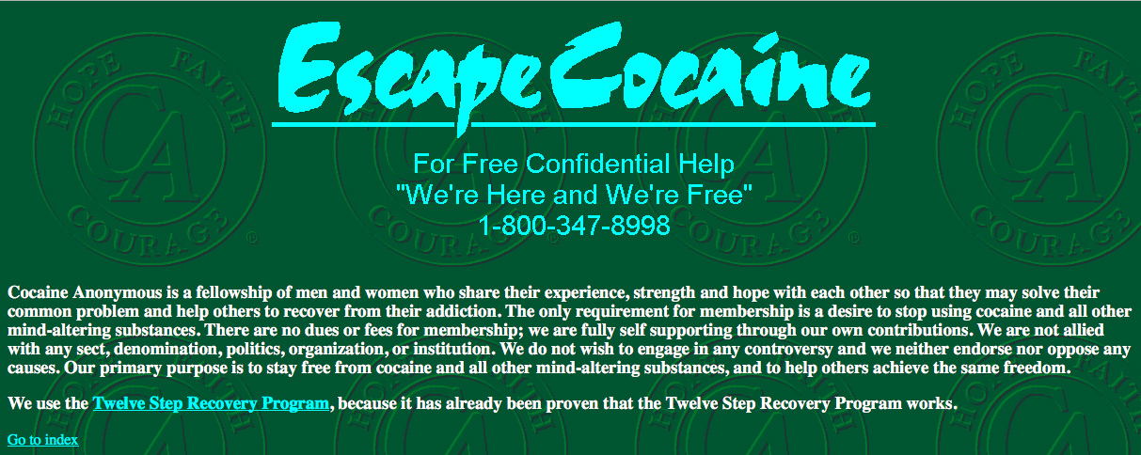
Getting Clean on the Screen!
CA.ORG
1994 Inception to 2025

Slide 55
1st C.A. Website – https://ca.org
Listen to Kevin M.
Our first ca.org webmaster
1994 - Two members of the 1994 Conference, Craig H. (Midwest Regional Trustee) and Jim S., a delegate from Northern California Area brought a motion to the Conference floor through the Public Information Committee. This motion was to obtain an internet domain (ca.org) and to put up a very limited web site on a server that Craig H. managed. The site was to be limited to the Preamble, the Self-Test and local telephone contact numbers. The “Escape Cocaine” billboard art was also used. This motion passed after considerable debate.
The domain, ca.org, was registered on October 20,1994. The site was online shortly thereafter generating a small number of telephone contacts to CAWSO. There was no e-mail address. CA was the first 12-Step Fellowship to have such a web site— AA.org (1996-04-24) and Al-Anon.org (1996-07-23), NA.org (1997-06-12) all put up sites in the following years. Kevin M. was our first Web Master.
1995 - PI brought a motion to the Conference floor to add certain specified information to the website, such as “What is CA?”, “…And All Other Mind-Altering Substances” and “To the Newcomer.” The motion passed with an amendment to allow the PI committee to add Conference-approved information at its discretion.
Kevin M. undertook a redesign of the website. More pieces were added: a page on the Storybook, the PI Fact File, the 12 Steps and 12 Traditions, “Crack”, and some of the results of the PI Survey of the previous year and an opening page describing the Fellowship and its goals. There was still no e-mail contact listed. This new version of the site went up, but it should have been reviewed and approved first by the WSBT and/or the WSOB, but none of them had Internet access!
1996 - The new website was formally announced at the Conference and made available for viewing by the fellowship. E-mail addresses for Public Information inquiries (pubinfo@ca.org) and for technical comments (webmaster@ca.org) were also created, and all of these addresses were listed on the web site.

Slide 56
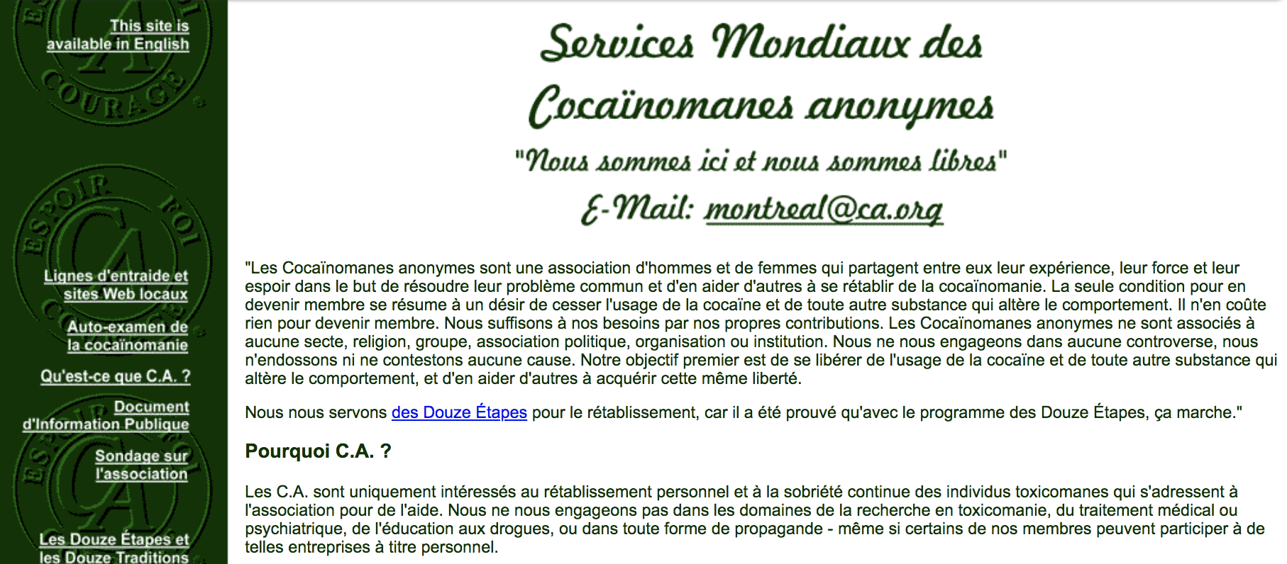
1st C.A. French Translation Website
https://web.archive.org/web/19980115064558/http://ca.org:80/francais/index.html
accessed 2021-02-05
1996 - A motion was passed at the 1996 World Conference that any future substantive changes to the site would require Trustee or Conference approval and a motion was passed to translate the web site into French. The Montreal Fellowship translated the web site into French, and provided text and detailed information on how that text correlated to the English version, so that posting the French web site was merely a technical issue. The French version of ca.org went up August 1, 1997, with WSO approval.

Slide 57


First Online C.A. Meetings
On February 1, 1997 the “Hope, Faith & Courage” (aka HFC) became the first online/virtual meeting facilitated through email.
Initially a speaker/discussion meeting patterned after AA’s “Lamplighters” online meeting, but soon changed to mostly a discussion format.
In time, the “speaker” portion of the meeting was replaced by inviting people celebrating a birthday to post their stories online. After a slow start, the meeting began to thrive. Due to the very low initial cost of operating the meeting, no 7th Tradition was taken initially. After some discussion, and a long talk with former Trustee Bob L, it was decided that the HFC meeting needed to take a 7th Tradition, as this was the only one of the 6 points regarding group status that HFC was not currently meeting.
1998 - In August, the second email subscriber meeting, "KISCA," was started.
1999 - Two more email meetings were formed, “Sisters in Sobriety” and “The Study.”
Web page capture (2001-02-20 on web.archive.org) of the first online C.A. group, Hope, Faith & Courage

Slide 58

https://ca-online.org

Slide 59

First Online C.A. Area
https://ca-online.org
1999-09-03 - The Conference approves the creation of an Online Service Committee and ca-online.org is registered on 1999-09-16.
2000-09-03 - The C.A. World Conference ratifies ca-online.org as a Cocaine Anonymous Online Service Area. OSA Delegates representing the OSA are: Michael C. (2 votes) and Alt. Del. Sherri H. (1 vote).
2001 “There is a Solution” meeting began.
2002 - “Steps On Line” meeting started.
2010 - Voice meetings were introduced.
2020 - Global pandemic starts and C.A. moves to the “ZOOM” platform. OSA experiences exponential growth.

Slide 60






1st Online C.A. Area
https://ca-online.org
Today the OSA has some 50 + virtual meetings with hundreds of members participating from countries throughout the Americas, Europe, Asia, Africa and Australia.

Slide 61







First Online C.A. Area
https://ca-online.org
Today the OSA has some 50 + virtual meetings with hundreds of members participating from countries throughout the Americas, Europe, Asia, Africa and Australia.

Slide 62

Cocaine Anonymous Online Recovery Area
https://onlinerecoveryarea.org

Slide 63












A 2nd C.A. Online Area started September 3rd, 2025, and is seeking ratification at the 2026 World Conference. Currently the ORA has 26 member groups with 35 weekly meetings.
(https://onlinerecoveryarea.org)

Slide 64








Slide 65

C.A. Online GB (Great Britain) Area
A Third C.A. Online Area Forms
The C.A. Online GB Area began as the Online District within the Area of CAUK in 2020 during the Covid-19 pandemic. Helping those who could not get to any face to face meetings, giving them the chance to begin or continue their recovery online. It began with just 6 aligned meetings.
By 2021, The Online District had increased to nine meetings. Momentum continued in 2022 with 13 groups now part of the District and in 2023 it had expanded to 21. The pace of growth accelerated and 36 groups had now joined by 2024, and in 2025 the number had peaked at 54 meetings.
https://caonline.org
The C.A. Online GB Area is the 3rd C.A. Online Area to come about with an inception date of January 16, 2026 and will seek ratification at the 2026 World Conference with currently 43 member groups and 85 weekly meetings.

Slide 66







In 2026, reflecting its maturity and international reach, the CAUK Online District voted with a 98% majority, to pursue global recognition. The district has now initiated the process to be formally acknowledged as the C.A. Online GB Area of the European Region.

Slide 67

Every Object
Has A Story
Created in March 2018 – The “C.A. Virtual Museum” promotes the value of a Cocaine Anonymous archives, highlighting interesting C.A. objects from around the world and their representative C.A. Areas. The C.A. Virtual Museum allows C.A. members to have greater access to their collective history.
https://museum.ca.org

Slide 68

The C.A.W.S. DOCUMENTS LIBRARY
(https://docs.ca.org)
A C.A. online, password protected Archive of World Conference, WSBT, WSOB Minutes. To date, we have a searchable database of the entire history of World Conference minutes and an almost complete history of World Service Office Board minutes and World Service Board of Trustee quarterly minutes.
The C.A.W.S. AUDIO LIBRARY: Currently we have audio files of 672 World Convention speakers from 1985 to 2025.

Slide 69

GET THE BOOK:
RECALLING THE EARLY DAYS OF C.A.
The stories in this book recall the experiences of some early members of Cocaine Anonymous (C.A.) through their eyes and memories.
Each member’s unique voice portrays different aspects of the early days of C.A.
Paperback book
https://shop.ca.org/products/recalling-the-early-days-of-c-a

Slide 70
C.A. 2026 Figures
Globally, C.A. has 82 Areas in 21 countries
Three (3) Global Online Areas
Approximately 6,000 C.A. Meetings worldwide
An estimated C.A. global membership of 60,000
42 World Service Conferences (Sep. 2026)
40 World Service Conventions (May 2026)

Slide 71
Preserve & Protect Your C.A. Area History!
Contact the CAWS Archive Committee
Email us: (archive@ca.org)
https://ca.org/service/world-service-conference/archives/archive-request-form/
Download the CAWS Archive Guidelines & Procedures Manual
https://ca.org/service/service-document-downloads/
How to build a C.A. Area Archive
https://museum.ca.org/tutorials/
'If you truly want to understand the present, or yourself, you must begin in the past. You see, history is not simply the study of the past. It is an explanation of the present.' - Paul Hunham (The Holdovers 2023)
As Archivists, We Can Protect C.A.’s Future
by Preserving C.A.’s Legacy

Slide 72
SOURCES
Cocaine Anonymous. 1993 Hope, Faith & Courage: Stories from the Fellowship of Cocaine Anonymous. Los Angeles, CA. Cocaine Anonymous World Services Inc.
Cocaine Anonymous. NewsGram 1987-2016. Cocaine Anonymous World.
Cocaine Anonymous. (1986) A Funny Thing Happened on the Way to AA. The Connection. Vol. 1, No. 1. p. 1, 5.
Cocaine Anonymous World Service Conference Minutes (1986, 1987)
Daltry, Laura. The New Hollywood Connection: Cocaine Anonymous. LA Times, Calendar: Sunday, December 26, 1982. p. 26.
History of C.A. Johnny S. and Ray G. 1990 - 6th C.A. World Service Convention. Phoenix, AZ, Cassette Tape
Original Cocaine Anonymous, Incorporation Papers (CA World Archives).
Schulz, David on How Cultures Remember. Feb. 2, 2015 https://www.humanities.org/blog/the-memory-of-the-masses-david-schulz-on-how-cultures-remember/
Sleeman, Patricia (2006) “Cultural Genocide,” Holland, A.C. and Manning, Kate, Editors. Archives and Archivists. pp. 187 – 199.

